Slide 1

12 - Priming
Classic Study
Use the 5 given words to create a 4-word sentence.
Prompt Response
WE CUP AFFORD CAN IT We can afford it.
METAL I WROTE LETTER THE
I A CASHED PEN CHECK
SKY WENT GRAY THE IS
HAS THE CAPITAL LINE HE
⋮

Slide 2
Would this descramble task affect your behavior in the next 5 – 10 minutes?
Would it improve your performance on a puzzle task?
Would it make you less willing to help someone?
Would it make you want to be alone?

Slide 3
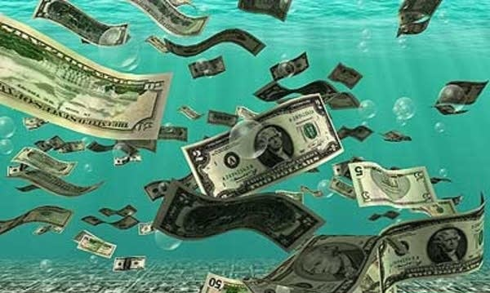
Money Priming Paper
Ss completed questionnaire. For ½ of Ss, task included subtle reminder of money.
Exp 1-4 Ss descrambled 30 sentences, and 15 were related to money
WE CUP AFFORD CAN IT We can afford it.
HAS THE CAPITAL LINE HE He has the capital
Exp 7-9 Ss sat near a PC with screensaver showing money
Later, Ss perform task seemingly unrelated to money.
(continued)

Slide 4
Results
Money priming dramatically altered behavior (compared to controls).
Exp 1 Money group worked 66% longer on a puzzle before quitting, d = 0.9
Exp 3 Money group volunteered only half as much time to help confederate
Exp 7 Money group chose to sit 60% farther away from their partner
Exp 9 Money group chose to work alone (vs. with partner) 200% more often, d = 1.4
Article appeared in Science
Findings reported in major news outlets around the world
Inspired a large literature devoted to money priming
2000+ citations
Vohs, Mead, and Goode (2006)

Slide 5
Another Priming Study
Ss descrambled sentences, and each sentence included one of these words.
WORRIED FLORIDA OLD LONELY
GREY SELFISHLY CAREFUL SENTIMENTAL
WISE STUBBORN COURTEOUS BINGO
WITHDRAW FORGETFUL RETIRED WRINKLE
RIGID TRADITIONAL BITTER OBEDIENT
CONSERVATIVE KNITS DEPENDENT ANCIENT
HELPLESS GULLIBLE CAUTIOUS ALONE
Would this task affect your behavior as you leave this class? If so, how?
Stimuli from Bargh, Chen, and Burrows (1996)

Slide 6
Elderly Priming aka the Florida Effect
College students descrambled sentences.
Prompt: ALWAYS WORRIED IS HE HOUSE
Response: He is always worried
Elderly Priming group: Each sentence included word that is weakly related to elderly, such as WORRIED, GULLIBLE, ALONE, or FLORIDA
Control group: No words related to elderly
As S left the lab, an E surreptitiously timed the duration of S’s walk down the hallway.
Results: Elderly Prime group walked much slower than Control group.
Bargh, Chen, and Burrows (1996). Exp 2A and 2B. J of Personality and Social Psych

Slide 7
Priming
Many priming are astonishing.
Reminder of money → more diligent, less helpful, less sociable ¹
Reminder of old age → walk slower ²
Thinking about professor → improved score on knowledge test ³
One exposure to U.S. flag → more likely to vote Republican 8 months later ⁴
Vohs, Mead, and Goode (2006). Science
Bargh, Chen, and Burrows (1996). J of Personality and Social Psychology
Dijksterhuis and van Knippenberg (1998). J of Personality and Social Psychology
Carter, Ferguson, and Hassin (2011). Psychological Science

Slide 8
But these effects cannot be replicated by other labs.
Nature (16 May 2012). Replication Studies: Bad Copy. Ed Yong
Nature (12 December 2019). A theory in crisis. Tom Chivers
Original Finding | Failed Direct Replications
Elderly priming (Bargh et al., 1996) | Doyen et al. (2012)
Money priming (Vohs et al., 2006) | Klein et al. (2014) Rohrer, Pashler, and Harris (2015, 2019)
Professor priming (Dijksterhuis & van Knippenberg, 1998) | O’Donnell et al. (2018) Shanks et al. (2013)
Flag priming (Carter et al., 2011) | Klein et al. (2014)

Slide 9
A Many Labs Replication
Each of 36 labs repeated 13 famous psychology findings.
2 of the 13 findings were priming effects.
Klein et al. (2014)
Klein et al. (2014)

Slide 10
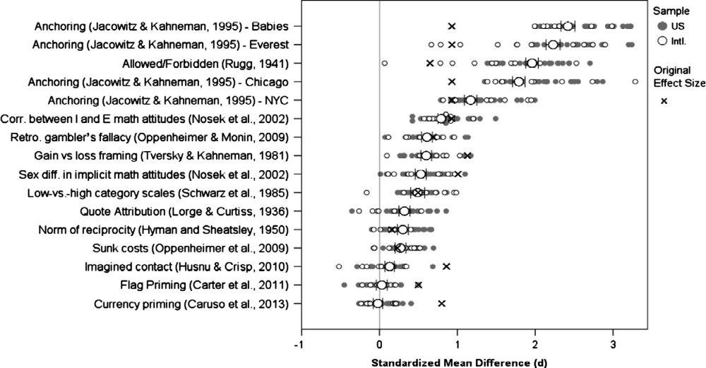
Results
The 2 priming effects were the only findings that did not replicate (effect size ≈ 0).
currency priming = money priming
 = original effect size
 = replication effect size
 = U.S. lab
 = non-U.S. lab
0
Effect Size

Slide 11
Another Many Labs Replication Attempt
Included all social science findings published in Nature or Science during 2010 - 2015.
Camerer et al. (2018). Nature Human Behaviour, 2, 637-644.

Slide 12
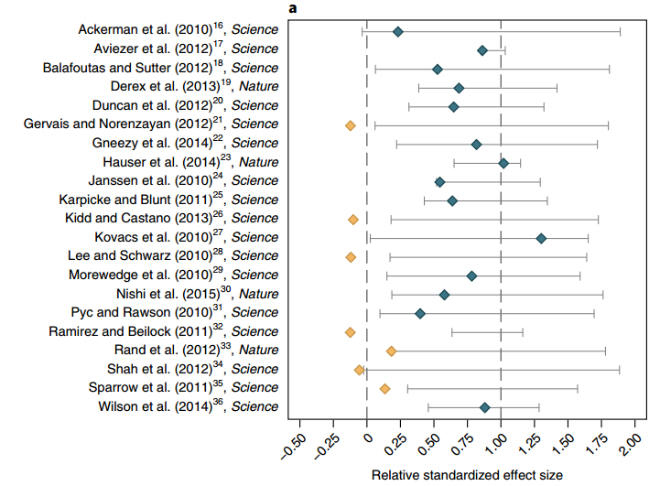
Results
Most social psych studies failed to replicate
Camerer et al. (2018). Nature Human Behaviour, 2, 637-644.
original effect size = 1
= replicated
(effect size > 0, p < .05)
◆ = not replicated
(effect size not sig.)

Slide 13
Many Other Remarkable Effects Do Not Replicate
Single writing task improved math performance
Ramirez and Beilock (2011), Science
Riding the Up Escalator improved mood
Sanna et al. (2011), J of Experimental Social Psych
retraction story
Wall poster improved factory workers’ productivity
Latham and Piccolo (2012), Human Resource Management

Slide 14
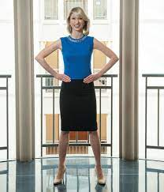
Power Posing
Amy Cuddy
Carney, Cuddy, and Yap (2010). Psychological Science
https://en.wikipedia.org/wiki/Power_posing
Carney’s retraction (2017)

Slide 15
Replicability Crisis
replicability crisis Controversy resulting from so man replication failures.
The scandal is possibly the biggest news story in the history of psychological science.
Hundreds of studies have been retracted (https://retractionwatch.com/).

Slide 16
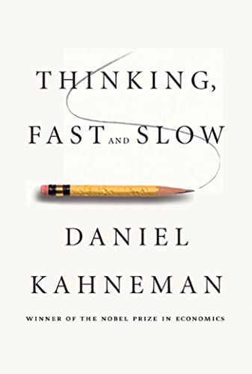
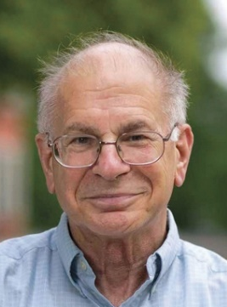
The Influence of Kahneman - Part 1
His 2011 New York Times best-selling book included chapter on priming.
Findings included money priming, elderly priming, and other remarkable effects.
He lauded the studies and famously wrote that “disbelief is not an option” (p. 57).
Daniel Kahneman
(1934 – 2024)
2002 Nobel Prize
in Economics

Slide 17
The Influence of Kahneman - Part 2
In 2012, Kahneman wrote an open letter to priming researchers.
He described the field as a “train wreck.”
… questions have been raised about the robustness of priming results.
… field is now the poster child for doubts about the integrity of psychological research.
… My reason for writing this letter is that I see a train wreck looming.
… I believe that you should collectively do something about this mess.
Yong (2012). Nobel laureate challenges psychologists to clean up their act. Nature

Slide 18
The Influence of Kahneman - Part 3
In 2022, Kahneman finally denounced the priming studies he helped make famous.
Ten years ago, when I was young and foolish, I published Thinking, Fast and Slow.
…
I was completely committed to believing those findings, and in arguing about them I made what I thought was a good point about science, that belief in results is not optional, that if a large and diverse body of published evidence supports a conclusion, you must believe in it. You are not allowed to believe only results that seem plausible to you.
…
Well, I was wrong, at least in that case. The studies of behavioral priming that I had cited in the chapter were largely discredited in the famous replication crisis of psychology. I'll come back later to what the authors of those studies made of this. As you may now expect they didn't change their mind, but I did. And I publicly retracted the chapter.
Kahneman (2022). Adversarial Collaboration. An EDGE lecture by Daniel Kahneman

Slide 19
Two Contributions to the Replicability Crisis

Slide 20
1. Publication Bias aka File Drawer Problem
Journals typically don’t publish null effects (though it’s now more common).
So, replication failures often remain buried in “file drawers.”
Thus, a lit review or meta-analysis can make an effect look large even if it’s not real.

Slide 21
2. p-hacking
p-hacking an inappropriate research practice that reduces p value.
Examples
Run many nearly identical studies but publish only the one that produced p < .05
Conduct study with many DVs but report only the DV that produced p < .05
Analyze the data several ways but report only the analysis that produced p < .05
Some p-hacking is rather benign (and, until recently, “socially acceptable.”)
Some p-hacking is outright fraud (fraud = intentional deception)
Simmons, Nelson, and Simonsohn (2011). Psychological Science, 22, 1359-1366.

Slide 22
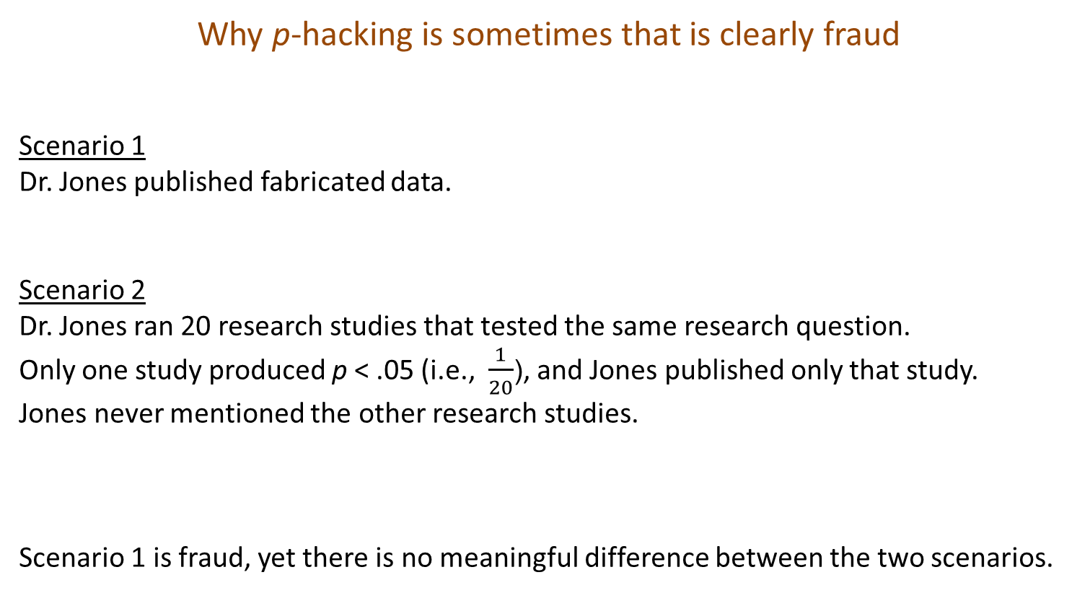
Why p-hacking is sometimes that is clearly fraud
Scenario 1
Dr. Jones published fabricated data.
Scenario 2
Dr. Jones ran 20 research studies that tested the same research question.
Only one study produced p < .05 (i.e., $\frac{1}{20}$), and Jones published only that study.
Jones never mentioned the other research studies.
Scenario 1 is fraud, yet there is no meaningful difference between the two scenarios.

Slide 23

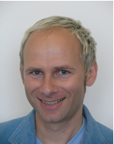
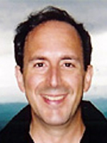
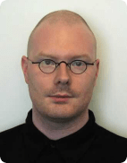
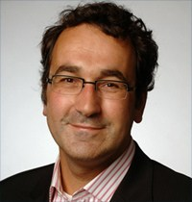
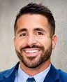
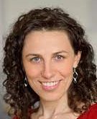
3. Data Fabrication
The replicability crisis is partly due to data fabrication or data falsification.
Some prominent examples:
1. Price, M. (2010). APA Monitor
2. van Kolfschooten, F. (2016). Science
3. Yong, E. (2012). Nature
4. Enserink, M. (2012). Science
5. Bhattacharjee, Y. (2013). The mind of a con man. The New York Times
6. Carey and Belluck (2015). The New York Times
7. Scheiber, Noam (2023). The New York Times and
Mather, Victor (2025). The New York Times
1. Karen
Ruggiero
2. Jens
Förster
3. Larry
Sanna
4. Dirk
Smeesters
5. Diederik
Stapel
6. Michael
LaCour
7. Francesca
Gino

Slide 24
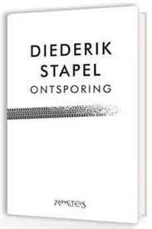
Diederik Stapel - Fraudster
Professor at Tilburg University (Netherlands)
Lost job in 2011 for fabricating and manipulating data
Fabricated data for many of his grad students’ theses.
58 publications retracted
Described his fraud in his 2012 book Derailment
https://en.wikipedia.org/wiki/Diederik_Stapel
Bhattacharjee, Y. (2013). The mind of a con man. The New York Times

Slide 25
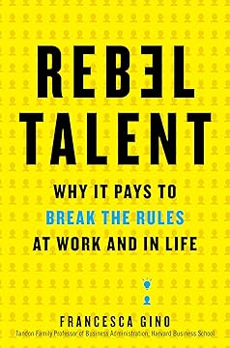
Francesca Gino - Fraudster
Professor at Harvard University
Much of her research focused on ethics and dishonesty
A trio of researchers found evidence of massive fraud
Harvard suspended Gino in 2023
Then Gino sued Harvard and 3 researchers for defamation
Judge dismissed lawsuit in 2024
Harvard fired Gino in 2025
Wrote 2019 book subtitled Why It Pays to Break the Rules …
https://en.wikipedia.org/wiki/Francesca_Gino
Scheiber, Noam (2023). NYT and Mather, Victor (2025). NYT

Slide 26
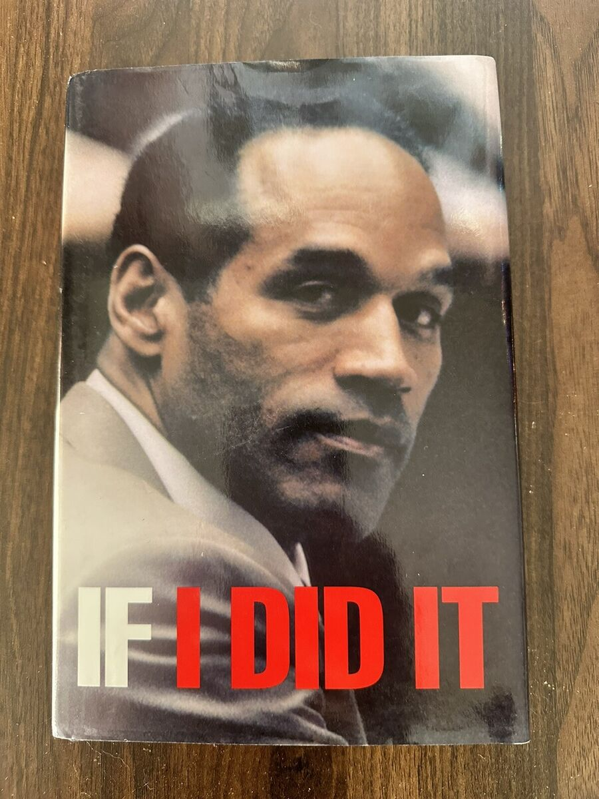
Gino book reminds me of OJ Simpson book

Slide 27
What happens when fraud is proven?
The research article is retracted. RetractionWatch
The fraudster is often told “Resign or you will be fired.”
Unfortunately,
Fraudsters usually receive no criminal punishment.
Their research funding is not returned to the university or government.
The fraudster’s university often covers up the incident.
If paper has multiple authors and the specific culprit(s) cannot be identified,
no authors are punished (e.g., Chatterjee, Rose, & Sinha, 2013).

Slide 28
Some Remedies for Replication Crisis
replication Replication studies are increasingly common.
preregistration Many journals require authors to preregister research plan.
Plan includes method, all measures, all planned data analyses.
open data Many journals require authors to publicly post their data before submitting their manuscript
Example
Many journals now require authors to include a transparency statement like this:
“The study was approved by the Institutional Review Board at the University of South Florida.
The hypothesis, method, and analyses were preregistered (https://osf.io/7vgt4). Materials and data are publicly available (https://osf.io/qr6te/). All data are reported accurately. None of the writing was plagiarized from work by a nonauthor.”

Slide 29
Takeaways
Many famous psychology findings are not real.
Lit reviews and meta-analyses are often tainted by publication bias.
One should be skeptical of bold claims that have not undergone direct replication.
Textbook authors should describe findings as either
tentative
or
well established (i.e., confirmed by multiple independent replications) ¹
¹ Pashler and De Ruiter (2017)

Slide 30
The End

