Slide 1
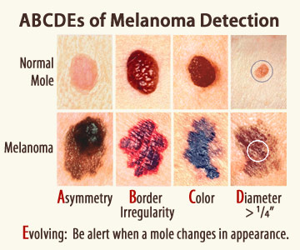

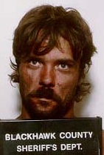
SIGNAL
DETECTION
Is this melanoma?
Did you hear a tone?
Is this the man who robbed you?

Slide 2
Pop Quiz
Which lesions are melanoma?
No | Yes | Yes | No | Yes
Not covered on exam
See www.melanoma.org

Slide 3
True/False Positives & True/False Negatives
med student’s response | Yes | No | Yes | No
Truth | Yes | Yes | No | No
 | True Positive (hit)
False Negative (miss)
False Positive (false alarm)
True Negative (correct rejection)
description =

Slide 4
True/False Positives & Negatives in a Table
Is it melanoma?
Is he the guy who robbed you?
 |  | Truth
 |  | Yes | No
Decision | Yes | True Positive (Hit) | False Positive (False Alarm)
 | No | False Negative (Miss) | True Negative (Correct Rejection)

Slide 5
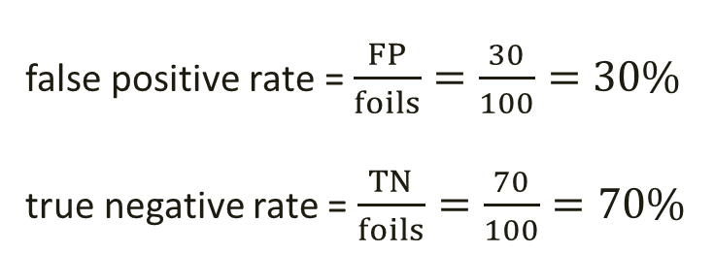
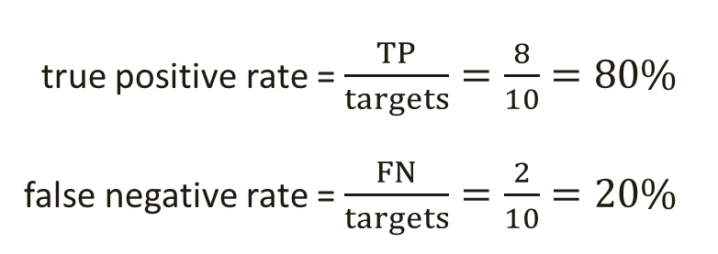
Measuring Performance
 |  | Truth
 |  | Yes | No
Decision | Yes | True Positive 8 | False Positive 30
 | No | False Negative 2 | True Negative 70
 |  | 10 targets | 100 foils
true positive rate = $\frac{TP}{targets}=\frac{8}{10}=80\%$
false negative rate = $\frac{FN}{targets}=\frac{2}{10}=20\%$
false positive rate = $\frac{FP}{foils}=\frac{30}{100}=30\%$
true negative rate =$\frac{TN}{foils}=\frac{70}{100}=70\%$

Slide 6
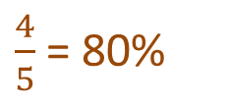
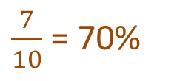
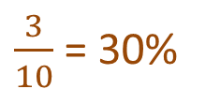
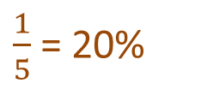
Example
A boy underwent a hearing test.
On each of 15 trials, a boy pressed a button if he heard a beep.
Photo from www.audiology.org
True Positive rate =
False Negative rate =
False Positive Rate =
True Negative Rate =
$\frac{4}{5}$ = 80%
 |  | Truth
 |  | Yes | No
Response | Yes | 4 TP | 3 FP
 | No | 1 FN | 7 TN
 |  | 5 | 10
$\frac{1}{5}$ = 20%
$\frac{3}{10}$ = 30%
$\frac{7}{10}$ = 70%

Slide 7
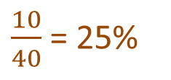
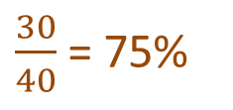
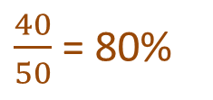
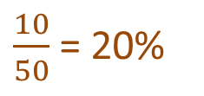
Example
Day 1 Ss studied face photos of 40 men, one at a time.
Day 2 Ss took yes-no recognition test with 40 targets and 50 foils.
Zoe responded YES to 30 targets and 10 foils.
 |  | Truth
 |  | Yes | No
Response | Yes
 | No
True Positive rate =
False Negative rate =
False Positive Rate =
True Negative Rate =
$\frac{30}{40}$ = 75%
$\frac{10}{40}$ = 25%
30 | 10
10 | 40
$\frac{10}{50}$ = 20%
40 50
$\frac{40}{50}$ = 80%

Slide 8
Example
Moe went to a memory researcher and said he had face blindness.
The researcher suspected he was a malingerer and decided to test Moe’s claim.
Moe saw 5 faces and then took a yes-no recognition test with 5 targets & 10 foils.
Results: true positive rate = 20% and false positive rate = 90%
The doctor immediately knew that Moe was a malingerer!
How?
If TP rate ≠ FP rate, then we know that Moe can distinguish targets from foils.
If he can distinguish targets from foils, he must not have face blindness.

Slide 9
Dilemma
Consider these two diagnostic tests for the flu.
1. Did you sneeze in 2025? If Yes, you have the flu. If No, you don’t have the flu.
TP =
FP =
2. Do you have 15 fingers? If Yes, you have the flu. If No, you don’t have the flu.
TP =
FP =
100% → perfect
100% → awful
0% → awful
0% → perfect

Slide 10
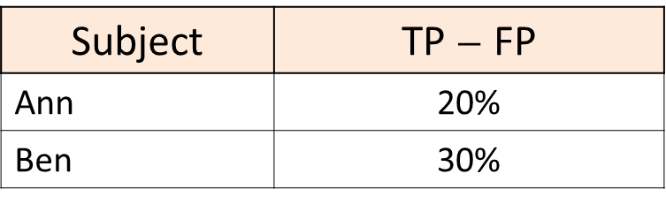
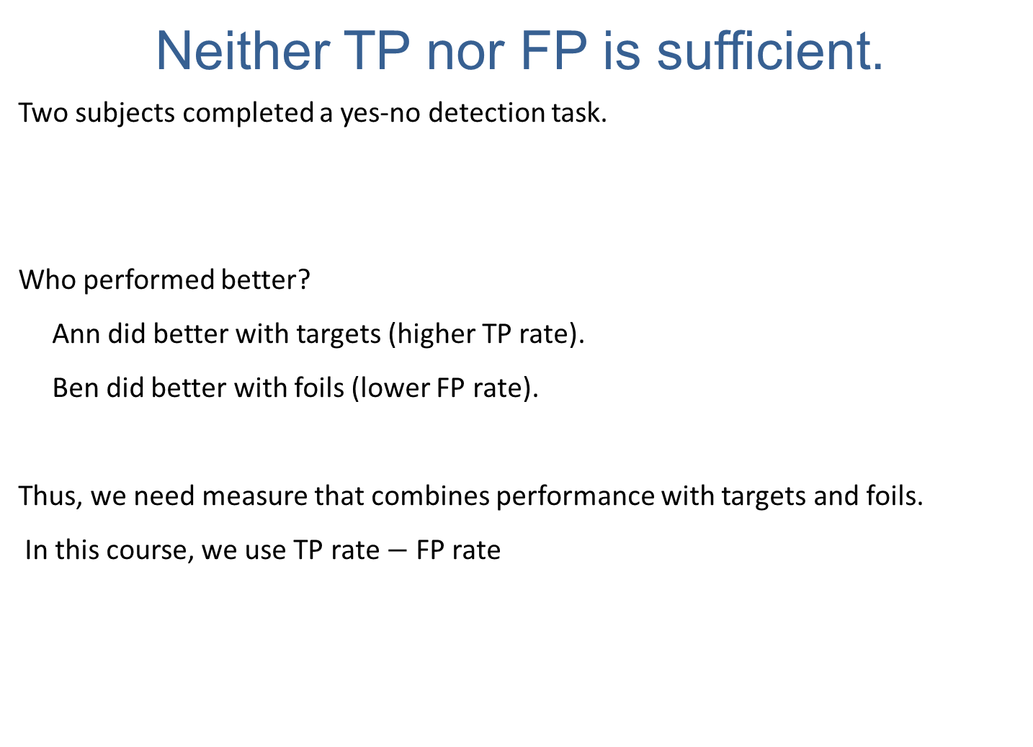
Neither TP nor FP is sufficient.
Two subjects completed a yes-no detection task.
Who performed better?
Ann did better with targets (higher TP rate).
Ben did better with foils (lower FP rate).
Thus, we need measure that combines performance with targets and foils.
In this course, we use TP rate $−$ FP rate
Subject | TP rate | FP rate
Ann | 80% | 60%
Ben | 50% | 20%
Subject | TP $−$ FP
Ann | 20%
Ben | 30%

Slide 11
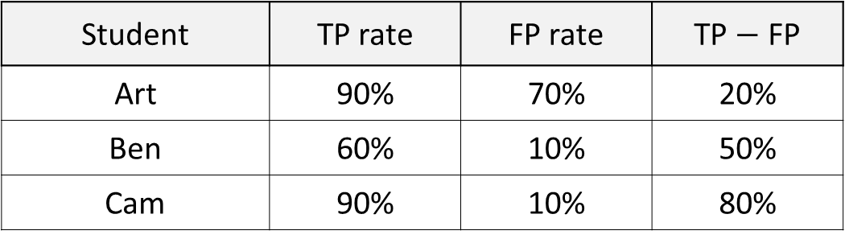
Example
Three med students classified lesion photos as melanoma (target) or not (foil).
Art did worst, Cam did best.
Student | TP rate | FP rate | TP $−$ FP
Art | 90% | 70% | 20%
Ben | 60% | 10% | 50%
Cam | 90% | 10% | 80%

Slide 12
There are many kinds of signal detection tasks.
Is that an enemy bomber or a flock of geese on the radar screen?
Should we hire/admit this applicant?
Is the patient schizophrenic?
Did you hear the beep?
Is the defendant guilty?
Should I reject H₀?
Is the man in the photo the same man who robbed you?

Slide 13
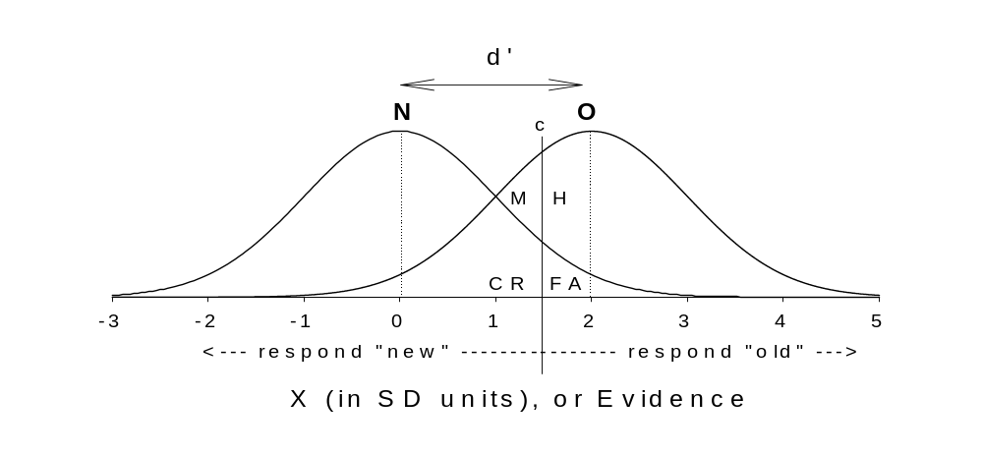
Students need not know the material below.
d’ is another measure of discriminability
Though TP – FP is simple, most researchers use d’ (read as “d prime”) or A’.
d’ = Z(TP) – Z(FA), where Z(x) is inverse of cumulative Gaussian distribution
d’ can be found with a web calculator www.eshedmargalit.com/dprime_calculator/
foils
targets
No
Yes

Slide 14
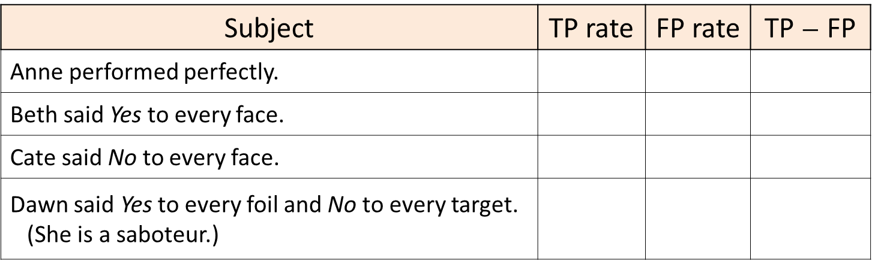
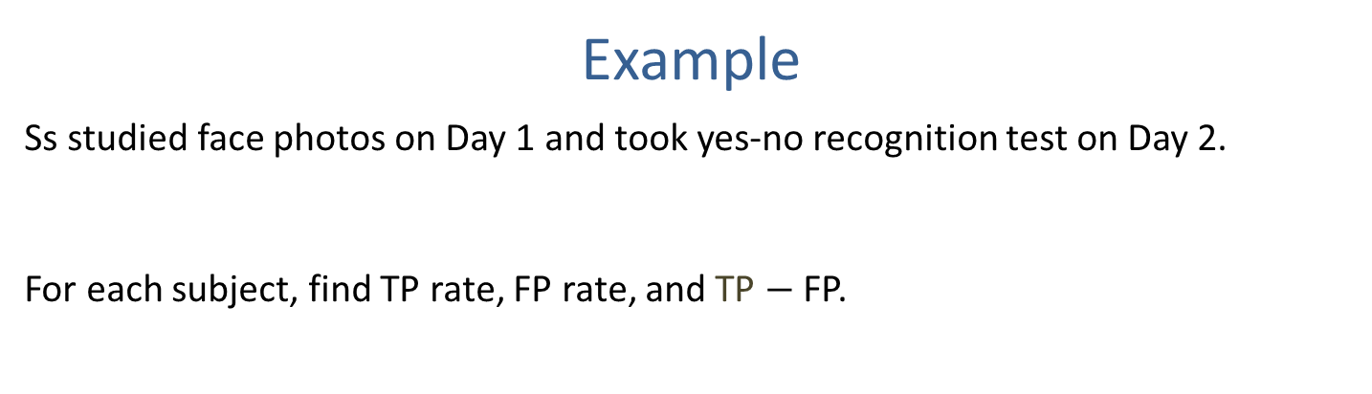

Example
Ss studied face photos on Day 1 and took yes-no recognition test on Day 2.
For each subject, find TP rate, FP rate, and TP $−$FP.
Subject | TP rate | FP rate | TP $−$ FP
Anne performed perfectly.
Beth said Yes to every face.
Cate said No to every face.
Dawn said Yes to every foil and No to every target. (She is a saboteur.)
100% | 0% | 100%
100% | 100% | 0%
0% | 0% | 0%
0% | 100% | $−$100%

Slide 15
The End

