Slide 1
Recall

Slide 2
Demo –digit span forward
          5 3 7 8 6 9
        6 6 9 4 5 2 8
7 4 2 6 9 8 5 7
8 8 1 6 3 7 2 4 9
9 6 2 5 7 3 4 9 8 1
10 9 3 8 2 4 7 1 5 3 6
11 5 8 1 4 7 9 3 2 6 1 7
12 6 9 5 1 7 2 8 5 3 7 2 4
Notes:
is faster easier or harder?

Slide 3
Span Task
S hears list of digits or words, usually a rate of one item per second.
Immediately afterwards, S repeats items aloud in order
span = greatest number of items that S can report in the correct order
Span task is part of many IQ tests
WISC-V (Wechsler Intelligence Scale for Children)
WAIS-V (Wechsler Adult Intelligence Scale)
Should it be?
(e.g., Baddeley, 2003; Cowan, 2005)

Slide 4
rehearsal loop
Most people perform span task by mentally rehearsing info (silently or aloud)
Examples
Rehearsing a phone number until you have a chance to jot it down
Rehearsing someone’s name so you’ll remember it later.
Mental arithmetic
23 x 15
= (20 x 15) + (3 x 15)
= 300 + 45
= 345

Slide 5
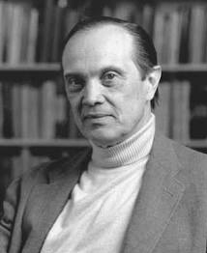
Without chunking or long-term memory tricks, what is typical memory span?
George Miller: 7± 2
Miller, G. A. (1956). The magical number seven, plus or minus two: Some limits on our capacity for processing information. Psychological Review, 63, 81-97.
My problem is that I have been persecuted by an integer.
For seven years this number has followed me around, has intruded in my most private data, and has assaulted me from the pages of our most public journals. … Either there really is something unusual about the number or else I am suffering from delusions of persecution.“ [first paragraph]
George Miller
(1920-2012)

Slide 6
Word Span Demo
6 words on each list
List 1 List 2
sum
hate
wit
bond
yield
twice
association
opportunity
representative
organization
considerable
immediately

Slide 7
Word Span Experiment – Word Length
6-word lists included only short words (1 syllable) or long words (5 syllables)
Results
Conclusion
span = amount of info that can be said in about 2 s
The magic number 7 is wrong
So, why does digit span equal 7?
(Baddeley et al., 1975)
long-word span < short-word span (word length effect)

Slide 8
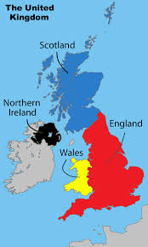
Long ago, IQ tests showed that English kids outscored Welsh kids on digit span
Are English kids brighter?
English Welsh
zero sero
one un
two dau
three tri
four pedwar
five pump
six chwech
seven saith
eight wyth
nine naw

Slide 9
Welsh-English Experiment
Welsh-English bilinguals completed digit span task in languages.
Results: English digit span > Welsh digit span
Implication: Digit span depends on time needed to “say” digit words
(Ellis & Hennelly, 1980)

Slide 10
Digit span demo
Arabic |  | Cantonese
0 | sifr | 0 | ling
1 | wahed | 1 | yat
2 | ithnan | 2 | yih
3 | thalatha | 3 | saam
4 | arba | 4 | sei
5 | khamse | 5 | ngh
6 | sitta | 6 | luhk
7 | seba | 7 | caht
8 | thamanya | 8 | baat
9 | tesa | 9 | gau

Slide 11
Correlational Study Comparing Speakers of Different Languages
Language (syllables / digit) digit span words read aloud in 2 s
English (1.2) 7.2 7.6
Arabic (2.3) 5.8 5.4
Conclusion
digit span = ~ 2 sec
(Naveh-Benjamin & Ayres, 1986)

Slide 12
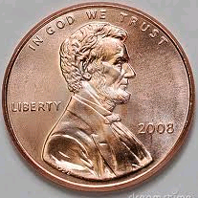
Long-Term Recall
On a penny, what appears to the left of Lincoln?
To the right?
We forget almost everything we once knew.
Is forgetting adaptive?
What causes forgetting?

Slide 13
Scenario
3:00 pm 4:00 pm 5:00 pm
You study History French Lab History exam
Your Friend study History rest History exam
Does the French Lab affect your score on History Exam?
NO forgetting due only to decay
amount forgotten depends solely on time elapsed since event
YES forgetting due at least partly to interference
learning X interferes with previously-learned Y
Notes:
What experiment answers this question?

Slide 14
Decay vs. Interference
Suppose you study for an exam for 3 hours and then immediately nap for 3 hours.
When you wake, does exam material seem more recent than if you had stayed awake?
Design an experiment.
Sleepers Study X Sleep Test on X
Wakers Study X Stay Awake Test on X

Slide 15
Sleep Experiment
Ss studied 10 nonsense syllables (DUT, WAB, RUK, …)
Ss then slept or remained awake during test delay of 1, 2, 4, or 8 hours.
Predictions
Decay-Only:
Interference:
(Jenkins & Dallenbach, 1924)
Sleep = Awake
Sleep > Awake
Test
Score
sleep
awake
1 2 4 8
Test Delay (h)
Notes:
Conclusion: The longer the test delay, the bigger the advantage.

Slide 16
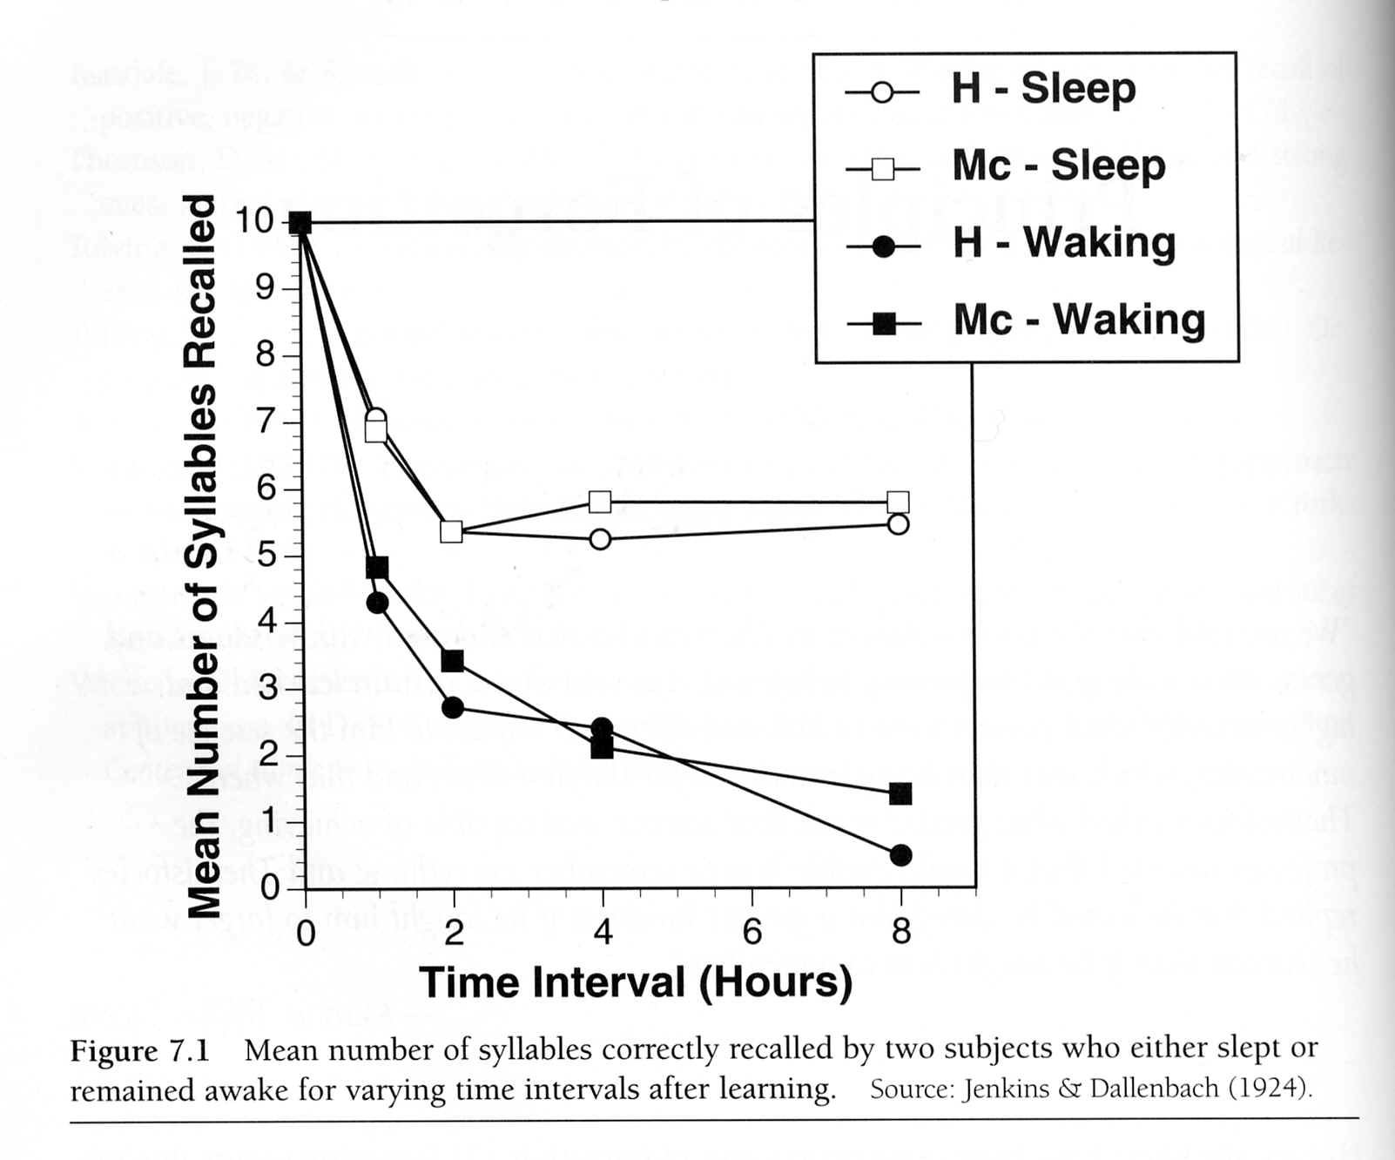
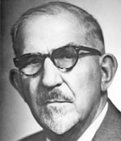
(Jenkins & Dallenbach, 1924)
Karl M. Dallenbach

Slide 17
Follow-Up
Why did sleepers forget?
Subjects in sleep condition probably did not fall asleep immediately.
Even a sleeping brain has some activity.
Perhaps forgetting is caused by both decay and interference.
Jenkins and Dallenbach (1924)
Test
Score
sleep
1 2 4 8
Test Delay (h)

Slide 18
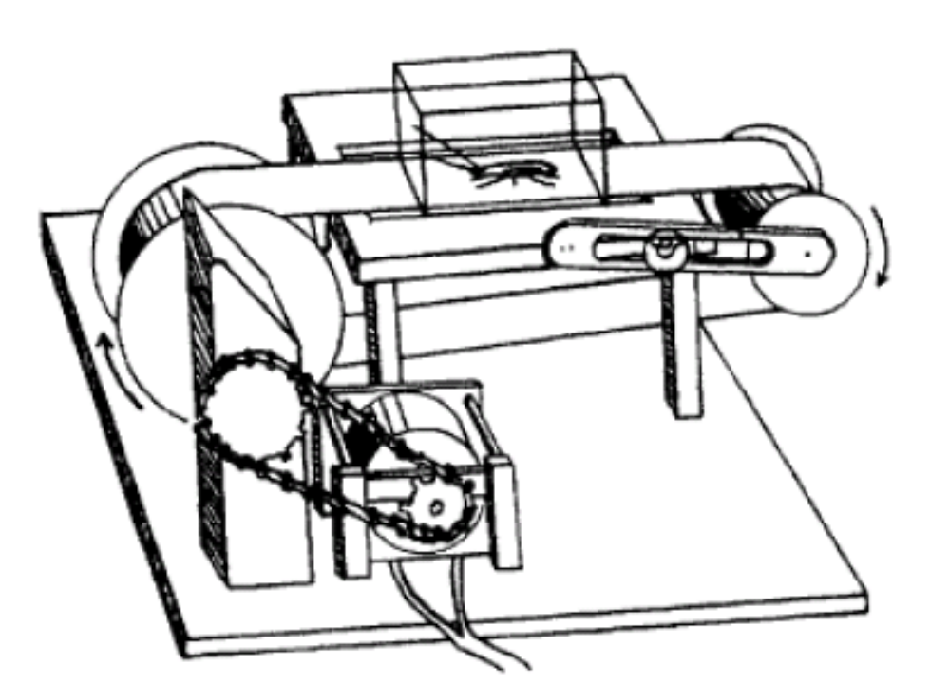
Follow-up Experiment
Roaches a learned to avoid shock.
Then roaches placed on treadmill or squeezed in matchbox.
One day later, “still” roaches showed no forgetting.
(Minami & Dallenbach, 1946)
Notes:
Practical Implications: To do well on test, study, and then sleep in cryogenic chamber
Need approval for roach? Toru says yes.

Slide 19
PI vs. RI
Proactive Interference (PI) prior learning hinders subsequent learning
Day 1 Day 2 Day 3
PI group Spanish French Test on French
Controls - - - - - - French Test on French
PI occurred if PI group did worse
Retroactive Interference (RI) subsequent learning hinders prior learning
Day 1 Day 2 Day 3
RI group Spanish French Test on Spanish
Control Group Spanish - - - - - Test on Spanish
RI occurred if RI group did worse
Notes:
In RI experiment, why not have control group study Spanish on Day 2

Slide 20
Example
Brie’s foreign language courses: Grade 10 Grade 11 Grade 12
French 1 Spanish 1 Spanish 2
Pop Quiz on first day of Spanish 2 in Grade 12:
GREEN vert (error)
DOG chien (error)
PI or RI?
PI
French Spanish Spanish Quiz
Prior learning interfered with subsequent learning

Slide 21
Example
Today, for the first time in her life, Jill used a numeric keypad.
She entered data for about an hour.
Then she phoned her friend. (She had used a phone all her life.)
When she tried to press “9,” she mistakenly pressed “3”.
PI or RI?
7 | 8 | 9
4 | 5 | 6
1 | 2 | 3
1 | 2 | 3
4 | 5 | 6
7 | 8 | 9
RI
Use phone (before today) use keypad Test on phone
subsequent learning interfered with prior learning

Slide 22
Example
A Brit flew to Tampa for his first trip outside the UK.
He rented a car and drove around Tampa for several days.
While driving at night, he saw oncoming car and veered left.
PI or RI?
PI
drive in UK drive in US test on US driving
Associated Press - Tampa - November 29, 2002
“A driver killed in a high-speed, head-on collision Wednesday after crossing the Sunshine Skyway on the wrong side was identified Thursday as a British citizen.”

Slide 23
Example
You once dated Chris. Now you date Pat.
Last night, while necking with Pat, you said, “Chris, you complete me.”
PI or RI?
PI
Chris Pat test on Pat
October 30, 2005
Dear Abby:
I am engaged to an otherwise great guy who has a bad habit. He calls me by his ex-wife's name. The first couple of times it happened, I called it a mistake. But now it happens habitually, and I'm at my wit's end. ...
I've had nightmares about it happening at the altar. I don't think I'd be big enough to forgive that. What do you think?
Name withheld

Slide 24
Why does interference occur?
Observation
After car accident, victim cannot recall last 15 minutes prior to accident.
Interpretation: brain trauma erased memory before it could consolidate
Experiment
ECT = electroconvulsive therapy
Group 1 study …ECT.….test
Group 2 study ………………………………….ECT.….test
Group 2 outscored Group 1.
Interpretation: ECT erased memory before it could consolidate
(Squire et al., 1975)

Slide 25
consolidation theory – an explanation of interference
1. Memory needs time to strengthen or “consolidate.” jello must harden
2. Until consolidation is complete, memory is vulnerable. jello can spill
3. Consolidation is disrupted by concurrent new learning. fridge door open
It’s as if the mind can consolidate only so many memories at once.
(e.g., Ribot, 1885; Wixted, 2005)

Slide 26
Example
Ned and Fred are identical twins who have led identical lives until today.
At noon, Ned and Fred studied History.
Then, Ned napped while Fred studied French.
Then, they took History test.
Ned History (1492 → Columbus) Nap History Test (1492-?)
Fred History (1492 → Columbus) French (dog-chien) History Test (1492-?)
Fred did worse; that is, RI impaired his recall of history
According to consolidation theory:
consolidation of French vocab impaired consolidation of History facts.

Slide 27
Memory Research and Ecological Validity
Many memory studies lack ecological validity (not generalizable to real world).
Subjects learn a list of unrelated words.
Subjects are tested just 20 seconds after they studied the material.
Recently, much more research relates to real-world tasks.
Classroom-based learning studies (Steven Pan, Roddy Roediger)
Eyewitness Memory (John Wixted, E. Loftus)
Remember to take medicine (Giles Einstein)
Notes:
Dr. Perfect

Slide 28
Experiment: Memory for Classmates
Ss were asked to remember names and faces from high school class
Time since graduation = 2 weeks - 57 years
Six tests, including cued name recall (see face photo, give name)
Sample Result
Time Since Graduation Cued Name Recall Accuracy
3 months 70%
25 years 50%
In general, all 6 tests revealed surprisingly little forgetting.
(Bahrick, Bahrick, & Wittlinger, 1975)
Notes:
By contrast, people forget everything they learned in school
caveats = not an experiment
confound: maybe older Ss went to smaller high schools
Ss were grouped into 9 groups by test delay. Oldest group has mean delay of 47.5, which explains graph on next slide
Tested 392 high school graduates for memory of names and portraits of classmates selected from yearbooks. The retention interval since graduation varied from 2 wks to 57 yrs. Performance was adjusted by multiple regression procedures to control the effects of various conditions on original learning and rehearsal of the material. Results show that identification and matching of names and faces remained approximately 90% correct for at least 15 yrs, even for members of very large classes. Free recall was independent of class size and recognition memory, and declined with negative acceleration by 60% during 48 yrs. This very slow forgetting process is attributed to distribution of practice and overlearning effects far more extreme than those observed in laboratory research. The decline of free recall is associated with the forgetting of the nature of the interpersonal relationship which serves as a retrieval mediator

Slide 29
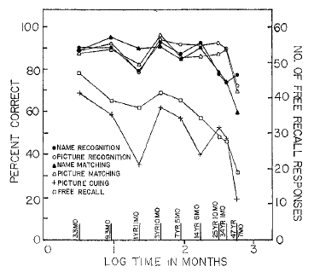
Yearbook study
Bahrick, Bahrick, and Wittlinger (1975)

Slide 30
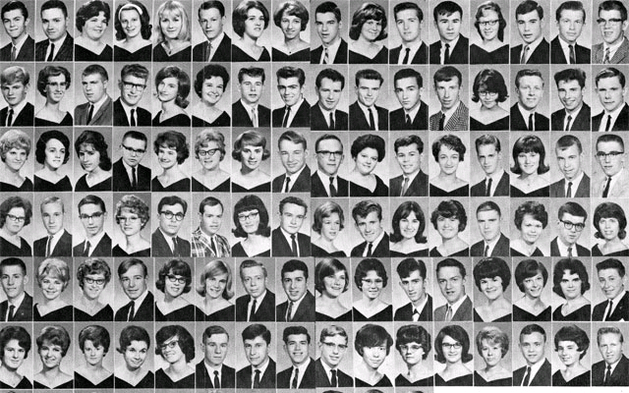
Could you recall high school classmate names if you saw their yearbook photos?

Slide 31
Is forgotten information entirely gone?
Example
You learned to count to 20 in Polish in 10 minutes.
When tested two weeks later, you scored 0.
But then you relearned the counting numbers in only 5 minutes.
So, your mind must have retained something.
Implication
Poor retention scores on first day of school can be misleading.
Ebbinghaus (1885)

Slide 32
Demo
Try to recall the author of each book.
Initials Name
Pride and Prejudice
War and Peace
Canterbury Tales
The Origin of Species
Gone with the Wind
Les Misérables
J A
L T
G C
C D
M M
V H
Jane Austen
Leo Tolstoy
Geoffrey Chaucer
Charles Darwin
Margaret Mitchell
Victor Hugo

Slide 33
retrieval failure
Memory cannot be recalled, but it is not forgotten
Examples
I could not recall her name, but I recognized it as soon as I heard it.
I could not recall who first sailed around world, but his name came to me later.
I cannot recall who assassinated Robert Kennedy, but his name begins with S.

Slide 34
Is the Tip-of-the-Tongue Experience Real?
Experiment
Ss heard definitions of rare words and were asked to give the word.
If Ss couldn’t, they were asked to give any partial information (e.g., 1st letter).
Question: Was accuracy greater than chance?
Results:
(Brown, 1991; Brown & McNeill, 1966)
Yes

Slide 35
TOT is universal
In a survey of 51 languages, 45 use tongue metaphor for TOT.
Italian punta della lingua On the tip/point of the tongue
Estonian keele otsa peal At the head of the tongue
Cheyenne navonotootse’a I have lost it on my tongue
Korean hyeu kkedu-te mam-dol-da sparkling at the end of the tongue ¹
Schwartz, B. L. (1999). Sparkling at the end of the tongue: The etiology of
tip-of-the-tongue phenomenology. Psychonomic Bulletin & Review.
1 Correction: going/hovering around my tip of the tongue.
Eunsun Lee, personal communication, February 15, 2023

Slide 36
1. Three-line verse with 5, 7, and 5 syllables per line
2. the three periods (...) that indicate an omission
3. create odd-shaped voting districts for political benefit
4. word that reads same forward or backward (e.g., tot)
5. Japanese art of paper folding
6. term for mammals with pouches (e.g., kangaroo)
7. tree that sheds leaves every year (unlike evergreens)
8. flying reptile that became extinct
9. word that is pronounced like its meaning (e.g., buzz)
10. mental disorder that causes people to steal
11. instrument used to measure wind speed
12. animal which eats plants and animals
13. person who explores a cave
1. haiku
2. ellipsis
3. gerrymander
4. palindrome
5. origami
6. marsupials
7. deciduous
8. pterodactyl
9. onomatopoeia
10. kleptomania
11. anemometer
12. omnivore
13. spelunker
Notes:
pterodactyl is a kind of pterosaur

Slide 37
Demo
You will quickly see 10 pairs of words.
tree palm
leader king
baseball pitcher
monkey banana
tennis racket
leather saddle
soccer ball
time noon
river bridge
fire hot
Distractor Task

Slide 38
Try to recall TARGET (second word of each pair)
1. queen king
2. fruit
3. horse
4. lunch
5. stove
6. wrist
7. lemonade
8. noise
9. dance
10. cards
Original Pairs
leader king
monkey banana
leather saddle
time noon
fire hot
tree palm
baseball pitcher
tennis racket
soccer ball
river bridge
banana
saddle
noon
hot
palm
pitcher
racket
ball
bridge

Slide 39
encoding specificity
recall improved if study context = test context
Experiment
Ss study related pairs (strawberry – JAM)
Test includes wrong-context cue (traffic - ?) or no cue
Cue doesn’t help.
Why not? Because words were “encoded” in a “specific” context.
(Tulving, 1970s)
Notes:
I sometimes use E.S. when trying to recall name of person I met

Slide 40
Internal State Dependence
You forget less if your mind or body is “in the same state” during study and test.
Results
Mood-matched Ss do slightly better on test.
 |  | Film Clip Just Before Test
 |  | Happy | Sad
Film Clip Just Before Studying | Happy | Better
 | Sad |  | Better

Slide 41
Another Experiment on Internal State Dependence
Ss pedal or sit still on stationary bike while studying and while taking test.
Results
Practical Implications?
True for learning while awake or asleep?
(Miles & Hardman, 1998)
 |  | During Test
 |  | pedal | Still
During Studying | pedal | 6 | 4
 | still | 3 | 7

Slide 42
Does chewing vs. not chewing gum produce context effects?
Miles: “More work needs to be done…”
2008
Miles, C., Charig, R., & Eva, H. (2008). Chewing gum as context: Effects in long-term memory. Journal of Behavioural and Neuroscience Research, Vol. 1 (6), 1-5.
Johnson, A., & Miles, C. (2008). Chewing gum and context-dependent memory: The independent roles of chewing gum and mint flavour. British Journal Of Psychology, 99, 293-306.
2007
Johnson, A. J., & Miles, C. (2007). Evidence against memorial facilitation and context-dependent memory effects through the chewing of gum. Appetite, 48(3), 394-396.
Miles, C., & Johnson, A. J. (2007). Chewing gum and context-dependent memory effects: A re-examination. Appetite, 48(2), 154-158.

Slide 43
External State Dependence
we forget less if study environment = test environment
Common Claims
You should study in the room where you will take the test.
If you smell odor X while studying, smelling odor X will help you remember.
Data don’t support these claims.
But it might be true under extreme circumstances?
Notes:
former student hyperventilated
how about temperature?

Slide 44
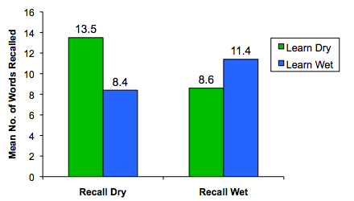
Experiment
Scuba divers studied a list of words underwater or on pool deck
½ Ss took recall test underwater, and ½ Ss took recall test on pool deck
Results
Conclusion
In extreme scenarios, matching external states may improve recall.
(Godden & Baddeley, 1975)

Slide 45
Interim Summary
Memory retrieval can improve if there is a match between study and test.
encoding specificity
internal state dependence
external state dependence
However, effects are usually small.

Slide 46
Summary
Forgetting
Decay vs. Interference
Proactive Interference vs. Retroactive Interference
Consolidation Theory
Cognitive Framework: Encoding, Storage, and Retrieval
Retrieval Failure
TOT
Links Between Encoding and Retrieval
Encoding Specificity
Internal State Dependence
External State Dependence

Slide 47
The End

Slide 48
Encoding specificity has been used to improve eyewitness memory
“First recall everything about crime scene. Now …”
(Geiselman et al., 1985)

Slide 49
Another experiment demonstrating encoding specificity
Ss read sentences, and the last word in each sentence was a thing.
For each thing, Ss saw one of two sentences.
Example
½ Ss read "The man lifted the piano." (weight context)
½ Ss read “The man tuned the piano." (music context)
Later, Ss given test: “Try to recall the last word of each sentence.”
During test, Ss received a cue for each word they were trying to recall.
Example
For piano, cue was “something heavy” or “something with a nice sound”
Results: Ss recalled 3 times as much if study context matched test cue.
(Barclay et al., 1974)

Slide 50
October 30, 2005
Dear Abby:
I am engaged to an otherwise great guy who has a bad habit. He calls me by his ex-wife's name. The first couple of times it happened, I called it a mistake. But now it happens habitually, and I'm at my wit's end.
...
I've had nightmares about it happening at the altar. I don't think I'd be big enough to forgive that. What do you think?

Slide 51
Interference causes more forgetting when learning material is similar.
Example
Joe takes French (vert-green) and Spanish (verde-green)
Moe takes French (vert-green) and German (grün-green)
French Test: What is French word for green?
Joe suffers more interference than Moe because vert and verde are similar.

Slide 52
Some terminology.
If you learn an association between items (face and name). to pair two items together two items “A-B” and later see “A” and try to recall “B” then
A is the cue and B is the target
Example
You meet fellow student.
Later, you see student and try to recall his or her name.
The face is the cue, and the name is the target.
Study Test
face-name face - ?

Slide 53
Part 2. learning new memory disrupts consolidation of recently-formed memory
Experiment
Ss voluntarily take benzodiazepine, which impairs memory for subsequent info.
Group first 5 min next 5 min last 5 min
Benzo Ss learn list A take benzo learn list B Test
Placebo Ss learn list A take placebo learn list B Test
Results
Test on List B list: Placebo Ss did better
Benzo impeded subsequent learning (this is just a biology fact)
Test on List A: Benzo Ss did better
Poor learning of list B → more resources for consolidation of list A
(e.g., Fillmore et al., 2001; Hinrichs et al., 1984; Weingartner et al., 1995)

Slide 54
Study
Ss played on rugby team. All Ss missed at least one game during the season.
Example Games
1 2 3 4 5 6 7 8 9
Player A      
Player B   
Sample Test Question
After game 9, Ss were asked “Who did you play in the 1st game?”
Predictions:
Decay: accuracy depends on # of days since 1st game A = B
Interference: accuracy depends on # of games played since 1st game A < B
Results supported interference.
(Baddeley & Hitch, 1977)

Slide 55
Why does interference occur?
One explanation is called cue overload theory
Cue (red) is paired with one or more targets (rouge, rojo)
rouge
red
rojo
Example
1:00 pm 2:00 pm 3:00 pm
study French (red-rouge) study Spanish (red-rojo) Spanish test (red-?)
Example
1:00 pm 2:00 pm 3:00 pm
study French (red-rouge) study Spanish (red-rojo) French test (red-?)
(e.g., Watkins, 1977)

Slide 56
Example of cue overload theory
Today, Joe parked in the same lot for the 10th consecutive day (different spot each day)
cue = where in this lot did I park?
cue is paired with 10 targets
cue overload → cannot find car
Today, Moe parked in a lot the first time
cue = where in this lot did I park?
cue is paired with only 1 target
No cue overload → can find car

Slide 57
But cue overload theory cannot be the only explanation of forgetting.
For instance, RI happens even if cue is linked to only one target
Example
1:00 pm 2:00 pm 3:00 pm
study French (red-rouge) study History French test (red-?)
study French (red-rouge) rest French test (red-?)
History impairs French test score!

Slide 58
Does span increase if items rhyme?
Trial 1 Trial 2 Trial 3 Trial 4
rope
dark
hand
moon
soft
fear
edge
rake
bake
make
lake
take
cake
fake
book
love
trap
wait
bird
head
wall
who
blue
view
do
coup
you
true
Notes:
How about words with similar spelling but different sounds? cough/trough, rough, though, thought

Slide 59
Word Span Experiment – Rhyming
Ss completed span task with lists consisting of words that rhymed or not.
Effect occurs even if rhyming words are spelled very differently
CREW WHO MOO THROUGH
Implication: For span task, info is stored as sound, not image.
Baddeley (1986)
rhyme span < non-rhyme span

Slide 60
Demo –digit span backward
      3 6 9 4
4 3 8 5 2
5 5 3 9 8 1
6 7 5 9 8 3 4
7 9 8 4 1 3 6 8
8 5 1 7 3 6 7 9 2

