Slide 1
1 - Research Methods
Empiricism
Experiments
Factorial Designs and Interactions

Slide 2
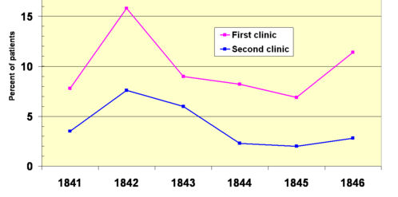
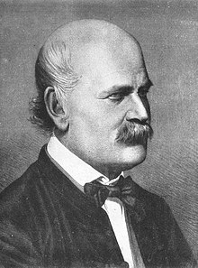
Case Study
Maternal mortality rate at two clinics in 1840s Vienna
Ignaz Semmelweis
(1818-1865)

Slide 3
Semmelweis learned of a key difference between two clinics:
At worse clinic, babies were delivered by med students who regularly conducted autopsies but rarely washed their hands.
Semmelweis blamed “cadaverous materials.”
1847 – Semmelweis convinced med students to wash their hands.
Mortality rate dropped ninefold within a month.

Slide 4
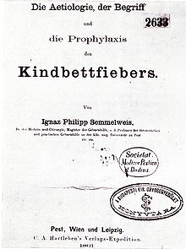
For years, Semmelweis tried to convince doctors to wash their hands.
Yet most prominent obstetricians ignored him or even mocked him.
1858, 1860, 1861, 1862
Dear Doctors,
Please see enclosed data. I recommend that you wash your hands before you deliver babies.
Ignaz Semmelweis
Dear Ignaz,
Sorry, but your data don’t fit with our theories.
Doctors

Slide 5
Takeaways from Case Study
Data trump theory
Theory should fit data – not the reverse!

Slide 6
Epilogue
The stress overwhelmed Semmelweis, and he began to act erratically.
In 1865, he was committed to an asylum, where he was beaten, confined to a cell, and placed in a straight jacket.
He died two weeks later.
Years later, Louis Pasteur put forth “Germ Theory of Disease.”
Source: Wikipedia

Slide 7
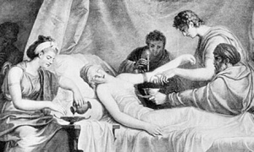
Medicine before Empiricism
For centuries, the most common medical treatment in Europe was bloodletting. Yet the procedure had no supporting evidence.

Slide 8
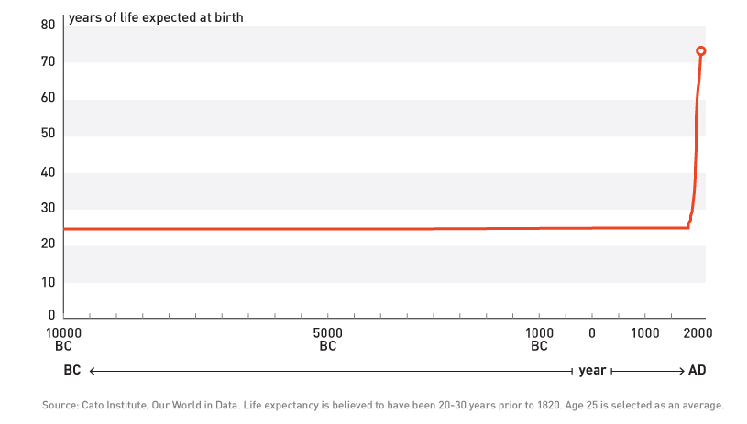
Global Life Expectancy Since 10,000 BC

Slide 9
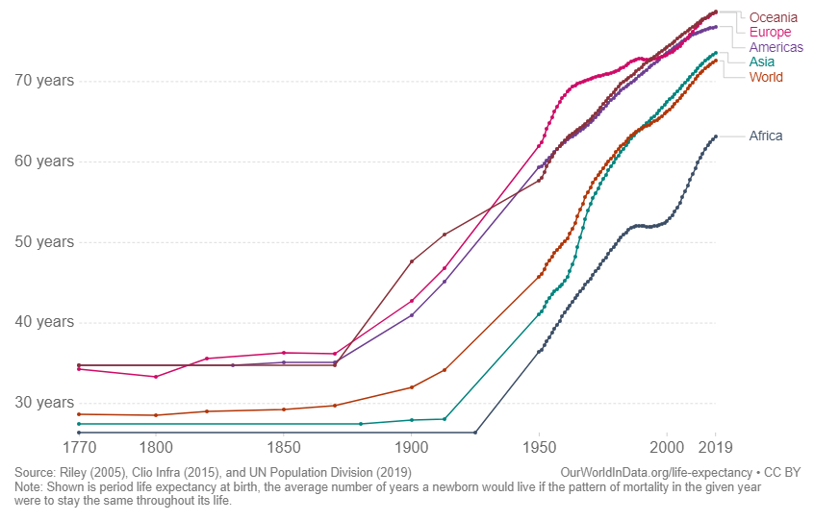
Life Expectancy, 1770 to 2019
Western medicine adopted
evidence-based approach

Slide 10
Empiricism
Empiricism Relying on observable evidence
Science is based on empiricism, not anecdotes, intuition, dogma

Slide 11
Experiment
In an experiment, researcher manipulates independent variable (IV)
and measures dependent variable (DV).
Only an experiment can demonstrate causation.
Example
IV = drug dose (0, 20, 40 mg)
DV = blood pressure

Slide 12
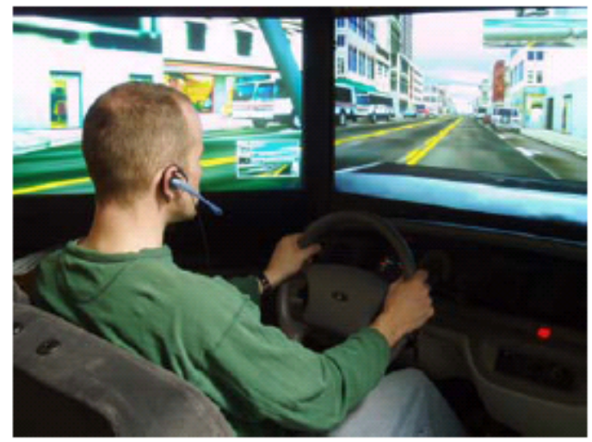
Distracted Driving
Ss drove in simulator while talking on hands-free cell phone or not.
Computer simulator recorded Ss’ brake time.
Results
hands-free phone 1112 ms
no phone 933 ms
1. Identify the IV.
2. How many levels does the IV have?
3. Identify the DV.
(Strayer et al., 2003)
Cellphone (yes vs. no)
2
Brake Time

Slide 13
Boy Toys
Girls placed in room with girl toys (e.g., dolls) and boy toys (e.g., cars).
Some girls had CAH (caused by in utero overexposure to male hormone)
CAH girls spent more time playing with boy toys than did non-CAH girls.
----------------------------------------------------------------------------------------
Does study show that CAH increases preference for boy toys? Explain.
(Berenbaum & Hines, 1992)
No. Girls were not randomly assigned to condition.
To show causation, IV must be manipulated.

Slide 14
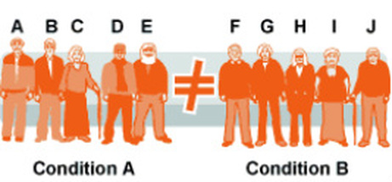
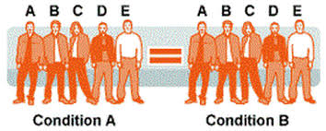
Between- vs. Within-Subjects
Between-Subjects IV Each S participates in only one level of the IV.
Example
½ Ss take drug, and ½ Ss take placebo
Within-Subjects IV Each S participates in every level of the IV.
Example
Ss receive drug for a month and
then receive placebo for a month.

Slide 15

Flashcard Study
Ss randomly assigned to one of two groups.
Self-Test group used flashcards (CASA? … HOUSE)
Rehearsal group mentally rehearsed (CASA-HOUSE)
Later, Ss took final test (PERRO-?, CASA-?, etc.)
Is the IV within-S or between-Ss?
Between-Ss

Slide 16

Gingko Study
Subjects: 3069 healthy older adults
By random assignment, each S received Gingko (240 mg/day) or placebo.
During next 6 years, researchers recorded who developed dementia.
Results: In each group, about 20% of people developed dementia.
Identify the IV.
Is the IV within-Ss or between-Ss?
Give the number of levels for the IV.
Identify the DV.
(DeKosky et al. JAMA 2008)
Gingko dose (0, 240 mg)
between-Ss
2
dementia rate

Slide 17
Eyewitness Distortion Study
Ss watched short film showing two-car collision.
Later, Ss were asked a question that was presented in one of five versions: “About how fast were the cars going when they
smashed / collided / bumped / hit / contacted each other. “
Identify the IV.
Indicate whether the IV is between-Ss or within-Ss.
3. Identify the DV.
(Loftus & Palmer, 1974)
Results | Verb
 | smashed | collided | bumped | hit | contacted
Mean Speed Estimate (mph) | 40.8 | 39.3 | 38.1 | 34.0 | 31.8
Verb (smashed, collided, bumped, hit, contacted)
between-Ss
Ss’ estimate of cars’ speed

Slide 18
Confound
Confound
An alternative explanation for an outcome of a research study due to a second (often unintentional) difference between groups or conditions.
Hypothetical study
Depressed people randomly assigned to one of two groups.
Sun group goes outside every day, and No-Sun group stays inside.
After a month, CES-D scores lower for Sun group than for No-Sun group.
Researcher concluded that sunlight alleviates depression.
Possible confound
Sun group exercised or socialized more than No-Sun group.

Slide 19
Hypothetical Study 1
On test, Spacers outscored Massers.
E concluded that spacing was more effective than massing.
Seem right?
7 days
30 days
Spacers
Massers
1 hour study
1 hour study
Test
30 days
1 hour study
Test
No. Confound = total study time
And the confound “worked for” the spacing group.

Slide 20
Hypothetical Study 2
On test, Spacers outscored Massers.
E concluded that spacing was more effective than massing.
Seem right?
Spacers
Massers
15 days
15 days
1 hour study
1 hour study
Test
30 days
2 hours study
Test
No. Confound = test delay
And the confound “worked for” the spacing group.

Slide 21
Factorial Design
factorial design = at least two IVs
IV = cell (yes, no)
IV = Age (20, 70)
DV = driving score
Number of conditions = 2 x 2 = 4
Each value in the table represents the mean for one condition.
hypothetical data
driving score | Cell | No Cell
Young | 5 | 9
Old | 3 | 6

Slide 22
Example 1 – Yoga
Yoga improved wellness, and benefit was greater for Women than for Men.
Thus, the effect of one IV depended on the level of the other IV.
We say that there is an interaction between the two IVs.
Women
8
wellness score
5
5
4
Men
Control Yoga Class

Slide 23
Example 2 – Yoga
Yoga improved wellness, and size of the benefit did not depend on Sex.
Thus, there was no interaction between the 2 IVs.
Women
8
7
wellness score
5
4
Men
Control Yoga Class

Slide 24
Example 3 – Yoga
Yoga improved wellness for Men but not for Women.
Thus, the benefit depends on Sex.
We say that Yoga (yes, no) and Sex (men, women) interacted.
Men
7
wellness score
5
5
Women
4
Control Yoga Class

Slide 25
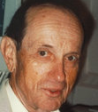
Bahrick, Bahrick, Bahrick, and Bahrick (1993)
The 4 authors were the only subjects!
Ss studied foreign language vocab (e.g., dog-chien).
Ss studied each list during 13 or 26 sessions.
The sessions for each list were separated (spaced apart) by 2, 4, or 8 weeks.
For each list, Ss were tested 1, 2, 3, or 5 years after their last study session.
1. Identify the IVs.
2. How many conditions?
Harry Bahrick
Born 1924
Bio
Number of Study Sessions (13, 26)
Spacing Interval (2, 4, 8 weeks)
Test Delay (1, 2, 3, 5 years)
24 (2 x 3 x 4)

Slide 26
Main Effects and Interactions
Main effect of Cell?
Yes. Cell phone impaired driving score (3 vs. 6)
Main effect of Age?
Yes. Young outscored old (7 vs. 2)
Interaction between Cell and Age?
Yes. Effect of Cell depended on Age. (Or Effect of Age depended on Cell.)
Young
Old
driving score | Cell | No Cell
Young | 5 | 9 | 7
Old | 1 | 3 | 2
 | 3 | 6
9
driving score
5
3
1
Cell No Cell

Slide 27
Possible Finding #1
Main effect of Cell?
Yes. Cell phone impaired driving score (3 vs. 6)
Main effect of Age?
Yes. Young outscored old (7 vs. 2)
Interaction between Cell and Age?
Yes. Effect of Cell depended on Age. (Or Effect of Age depended on Cell.)
Tip: An interaction occurs if and only if line segments are not parallel.
Young
Old
driving score | Cell | No Cell
Young | 5 | 9 | 7
Old | 1 | 3 | 2
 | 3 | 6
9
driving score
5
3
1
Cell No Cell

Slide 28
Possible Finding #2
Main effect of Cell?
Yes. Cell impaired driving score (4 vs. 8)
Main effect of Age?
Yes. Young outscored old (7 vs. 5)
Interaction between Cell and Age?
No. Cell had same negative effect on Young (9 → 5) and Old (7 →3).
Note: This was the outcome found by Strayer and Drews (2004).
driving score | Cell | No Cell
Young | 5 | 9 | 7
Old | 3 | 7 | 5
 | 4 | 8
Young
Old
driving score
Cell No Cell

Slide 29
Possible Finding #3
Main effect of Cell?
Main effect of Age?
Interaction between Cell and Age?
Young
Old
driving score | Cell | No Cell
Young | 5 | 7 | 6
Old | 3 | 9 | 6
 | 4 | 8
driving score
Cell No Cell
Yes. Cell impaired driving score (4 vs. 8)
No. Young = Old (6 vs. 6)
Yes. Effect of Cell depended on Age.
Tip: An interaction occurs if and only if line segments are not parallel.

Slide 30
Possible Finding #4
Main effect of Cell?
Main effect of Age?
Interaction between Cell and Age?
Young
Old
driving score | Cell | No Cell
Young | 3 | 7 | 5
Old | 3 | 7 | 5
 | 3 | 7
driving score
Cell No Cell
Yes. Cell impaired driving score (3 vs. 7)
No. Young = Old (5 vs. 5)
No. Cell equally impaired Young (7 → 3) and Old (7 → 3).

Slide 31
Possible Finding #5
Main effect of Cell?
Main effect of Age?
Interaction between Cell and Age?
.
Young
Old
driving score | Cell | No Cell
Young | 9 | 5 | 7
Old | 1 | 5 | 3
 | 5 | 5
driving score
Cell No Cell
No. Cell = No Cell (5 vs. 5)
Yes. Young outscored Old (7 vs. 3)
Yes. Cell helped Young (5 → 9) but impaired Old (9 → 5).
Tip: An interaction occurs if and only if line segments are not parallel.

Slide 32
Possible Finding #6
Main effect of Cell?
Main effect of Age?
Interaction between Cell Phone and Age?
Young
Old
driving score | Cell | No Cell
Young | 8 | 8
Old | 2 | 2
driving score
Cell No Cell
No. Cell = No Cell (5 vs. 5)
Yes. Young outscored Old (8 vs. 2)
No. Cell had no effect on Young (8 → 8) and no effect on Old (2 → 2 ).

Slide 33
Possible Finding #7
Main effect of Cell?
Main effect of Age?
Interaction between Cell and Age?
Young
Old
driving score | Cell | No Cell
Young | 8 | 2
Old | 2 | 8
driving score
Cell No Cell
No. Cell = No Cell (5 vs. 5)
No. Young = Old (5 vs. 5)
Yes. Cell helped Young (2 → 8) yet impaired Old (8 → 2).
In other words, effect of Cell depended on Age.

Slide 34
Possible Finding #8
Main effect of Cell?
Main effect of Age?
Interaction between Cell and Age?
driving score | Cell | No Cell
Young | 6 | 6 | 6
Old | 6 | 6 | 6
 | 6 | 6
Young
Old
driving score
Cell No Cell
No. Cell = No Cell (6 vs. 6)
No. Young = Old (6 vs. 6)
No. Cell had no effect on Young and no effect on Old.

Slide 35
Summary of Possible Findings 1-8
 | Main Effect of Cell | Main Effect of Age | Interaction between Cell and Age
1 | Yes | Yes | Yes
2 | Yes | Yes | No
3 | Yes | No | Yes
4 | Yes | No | No
5 | No | Yes | Yes
6 | No | Yes | No
7 | No | No | Yes
8 | No | No | No

Slide 36
Scuba Diver Study
18 scuba divers studied two lists of words: one underwater, one on land.
Later, subjects were tested on both word lists.
9 Ss were tested underwater, and 9 Ss were tested on land.
DV = number of words recalled.
1. Let the IVs be called Study (dry, wet) and Test (dry, wet).
Identify the within-Ss IV(s), if any.
Identify the between-Ss IV(s), if any.
2. Determine the number the conditions.
3. What result do you expect?
(Godden & Baddeley, 1975)
Study (dry, wet)
Test (dry, wet)
2 x 2 = 4

Slide 37
Scuba Diver Study Results
Main effect of Study (dry, wet)?
Main effect of Test (dry, wet)?
Which variables interacted, if any?
 |  | Test
 |  | Dry | Wet
Study | Dry | 14 | 8
 | Wet | 9 | 11
14
11
Wet
Dry
Test
Score
Study
9
8
Dry Wet
Test
Yes. Dry Study (11) > Wet Study (10)
Yes. Dry Test (11.5) > Wet Test (9.5)
Study (Dry, Wet) and Test (dry, wet)
Interaction shows that optimal study environment (dry or wet) depends on test environment (dry or wet).

Slide 38
The End

