Slide 1
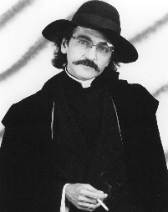
Learning
Students forget nearly everything they once learned.
How can students learn better?
Five-minute university (3:55)
www.youtube.com/watch?v=kO8x8eoU3L4
(Don Novello)
Notes:
Free course

Slide 2
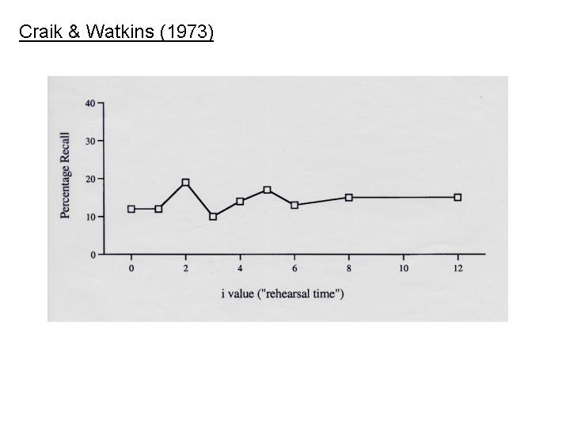
g-word study
Ss heard list of words and repeated aloud the last word beginning with a g.
HEAR: GET GUM TOY GEM GEM GEM GEM RED …
SAY: get gum gum gem gem gem gem gem
Each g word repeated 0 - 12 times.
Surprise recall test.
Implication:
(Craik & Watkins, 1973)
# of g words recalled
0 1 2 3 4 5 6 8 12
# of repetitions
Mindless repetition is useless.

Slide 3
Shallow vs. Deep Experiment
Ss heard list of words.
After each word, Ss answered a question.
½ Ss: Does it include an “e” ? shallow processing
½ Ss: Is the word pleasant? deep processing (think about meaning)
Later, Ss took surprise test.
Results deep >> shallow
Implication
Students should think about what they hear and read (obviously).
(Craik & Lockhart, 1972)

Slide 4
Reading
  I recommend it!
  But reading often lead to poor learning and even the illusion of learning.
  sham reading
  reading without understanding
  Reading is often helpful but not always sufficient.

Slide 5
Demo
The procedure is actually quite simple. First you arrange things into different groups depending on their makeup. Of course, one pile may be sufficient depending on how much there is to do. If you have to go somewhere else due to lack of facilities, that is the next step; otherwise you are pretty well set. It is important not to overdo any particular endeavor. That is, it is better to do too few things at once than too many. In the short run, this may not seem important, but complications from doing too many can easily arise. A mistake can be expensive as well. The manipulation of the appropriate mechanisms should be self-explanatory, and we need not dwell on it here. At first the whole procedure will seem complicated. Soon, however, it will become just another facet of life. It is difficult to foresee any end to the necessity for this task in the immediate future, but then one never can tell.
(Bransford & Johnson, 1972)

Slide 6
Experiment
Ss read passage with or without its title.
Passage was incomprehensible without its title.
When tested for gist, Ss better recalled titled passages.
Implication
Comprehension improves recall (obvious but unheeded advice).
(Bransford & Johnson, 1972)
Notes:
Reading is overrated

Slide 7
Demo
A newspaper is better than a magazine. A seashore is a better place than the street. At first it is better to run than to walk. You may have to try several times. It takes some skill but it is easy to learn. Even young children can enjoy it. Once successful, complications are minimal. Birds seldom get too close. Rain, however, soaks in very fast. Too many people doing the same thing can also cause problems. One needs lots of room. If there are no complications it can be very peaceful. A rock will serve as an anchor. If things break loose from it, you will not get a second chance.

Slide 8

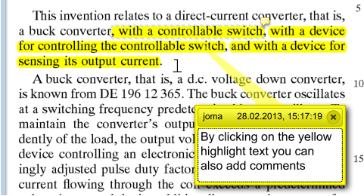

Does highlighting improve learning?

Slide 9
Highlighting Experiment
Ss read 8000-word article from Scientific American
3 groups:
active highlighters (Ss told to highlight “particularly important” text)
passive highlighters (text is pre-highlighted)
read
One week later, Ss spend 10 minutes looking article and then take test.
Results
(Fowler & Barker, 1974)
No differences between groups

Slide 10
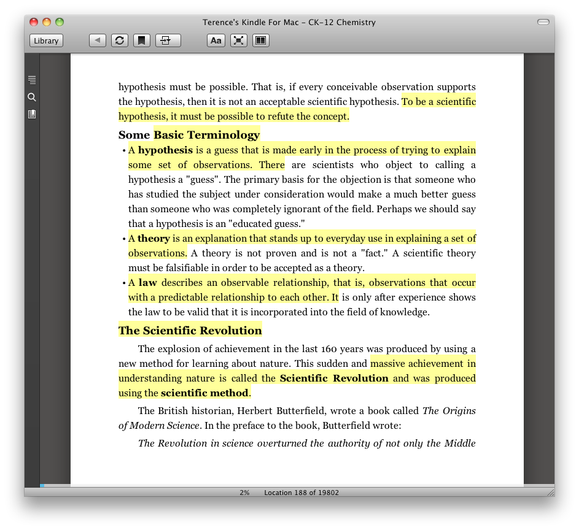
Summary of Highlighting Studies
Highlighting can be useful (e.g., marking a location),
but it doesn’t improve learning because it doesn’t require understanding.
(For a review, see Dunlosky, Rawson, Marsh, Nathan, & Willingham, 2013)

Slide 11
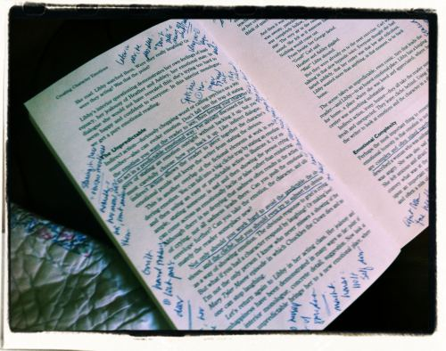

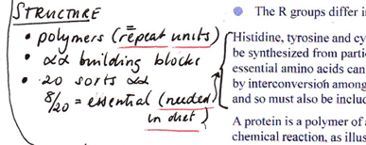
Does Self-Explanation improve learning?
Taking notes while reading article
Taking notes while listening to lecture
Write summary after reading chapter
Self-explanation supported by strong evidence
(For reviews, see Dunlosky et al., 2013; Roediger & Pyc, 2012)

Slide 12
Self-Explanation Experiment
Ss read chapter in Biology text
½ Ss were periodically interrupted and asked to explain what they just read.
½ Ss read and reread chapter.
Total study time equated.
On final test, Explainers outscored Rereaders.
(Smith et al., 2010)
Notes:
Example. The Mona Lisa Experiment

Slide 13
Summary of Self-Explanation Evidence
Self-explanation supported by strong evidence
Students should take notes while reading and attending lecture
Dilemma
Providing students with lecture slides can improve clarity of lecture, but many students rely solely on slides and don’t take notes (PowerPoint Effect).
(For reviews, see Dunlosky et al., 2013; Roediger & Pyc, 2012)

Slide 14
Answer Feedback
Student is shown correct answer after attempt.
Good evidence supports this (obvious) strategy, but the advice is often ignored.
Many teachers don’t correct spelling or grammar errors.
Many students don’t bother to look at answer key.

Slide 15



Retrieval Practice aka Self-Testing
Student tries to recall info and then sees correct answer.
Flashcards
Apps
Demo
https://www.sheppardsoftware.com/Geography.htm
Demo

Slide 16
Retrieval Practice Experiment
Ss cycled through Swahili-English flashcards using 1 or 2 strategies
Study-Only
MASHUA – BOAT
LESO – SCARF
⋮
Retrieval Practice (with feedback)
MASHUA - ? … BOAT
LESO - ? … SCARF
⋮
Total learning time equated.
On final test, Retrieval Practice > Study-Only
Conclusion: Memory retrieval, whether successful or not, improves learning.
(Karpicke & Roediger, 2008)

Slide 17
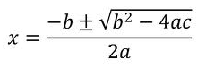
Retrieval Practice Caveat
Sometimes, knowing a fact is necessary but not sufficient.
Example
Student memorized quadratic formula but doesn’t know how to use it.

Slide 18
Retrieval Practice is underutilized
Some disciplines inherently require retrieval practice.
Writing requires recall of spelling and syntax
Math solving problems require recall
Spanish responding to teacher’s oral query (¿Cómo estás?)
Many do not.
History
Geography
Psychology

Slide 19
Retrieval Practice Takeaway
Tests improve learning and not only assess learning (if answers provided later).
Tests should be frequent.
practice questions during lecture and in textbook (with answers)
self-testing (practice problems, learning apps)
frequent quizzes
Tests let students know how well they know material (avoid overconfidence).

Slide 20
Spaced Practice aka Distributed Practice
Distributing a fixed amount of study effort over a longer time interval
Which French course produces better long-lasting learning?
Semester Course 3 hours per week for 15 weeks = 45 hours
Intensive Course 15 hours per week for 3 weeks = 45 hours

Slide 21
Spacing Experiment
English-learning students were asked to correct non-grammatical sentences.
I have seen the movie with my brother last week.
How long did you sit in this classroom so far this morning?
5 practice sessions
IVs = Gap x Test Delay

Slide 22
Results
Implications
Intensive foreign language courses do not yield long-term retention. quickly learned → quickly forgotten
Steve Bird (2010). Applied Psycholinguistics.

Slide 23
Spacing Takeaway
Spacing effect is one of the largest and most robust effects in learning science.
Some implications:
Cumulative exams are good.
Short courses are bad (e.g., 6-week summer course).
Ensure that spacing gaps are large.
  Typical Weekly vocab list includes 15 new words
Better Weekly vocab list includes 10 new words and 5 old words
Caveat: Spacing effect shrinks as test delay shortens
So last-minute cramming might be okay if short-term retention is goal.
(upcoming trip to Paris)

Slide 24
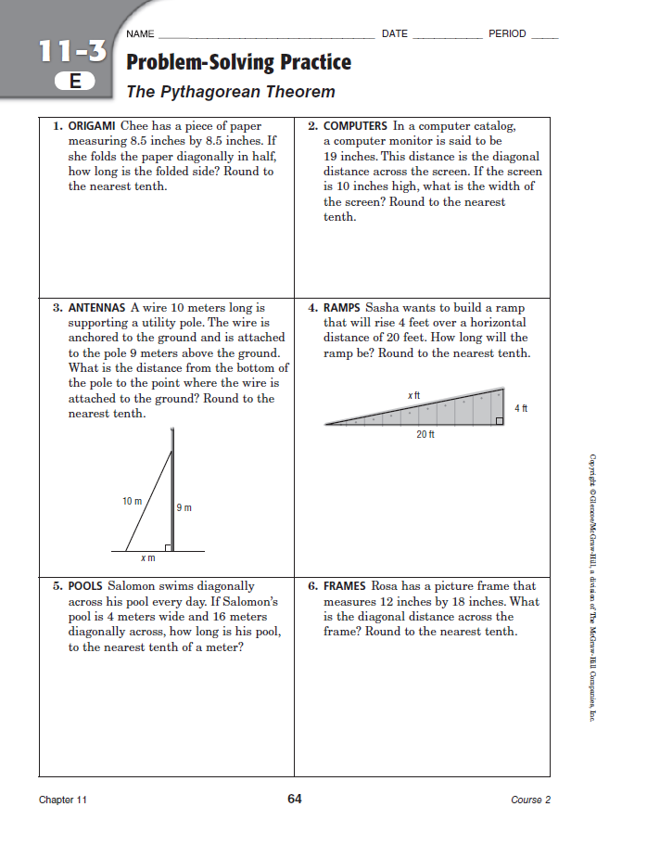

Most math practice assignments are devoted to the same topic
With such blocked practice, students need not learn how to choose a strategy.
They often know the strategy for a problem before they read the problem!

Slide 25
But students must learn to choose a strategy – not just use it
Zoe kayaks 24 km east and then 7 km north.
How far is she from her starting point?
Without learning to choose, students might do well on weekly quiz,
but they will struggle on cumulative exam (semester final, standardized exam).
1. Choose strategy Pythagorean Theorem
?
7 north
2. Use strategy c² = 24² + 7² c = 25 km
24 east
Notes:
The term strategy is used loosely to mean procedure, concept, formula, theorem

Slide 26
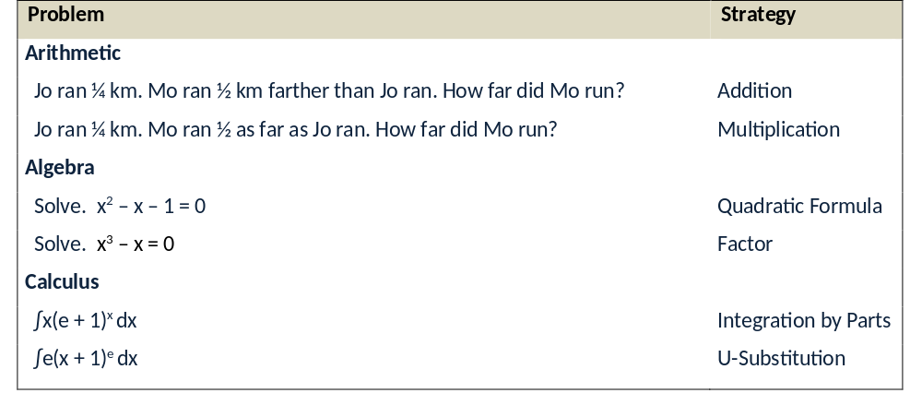
All math disciplines require fiendishly-difficult discriminations.
Statistics
blah blah two conditions blah blah repeated-measures t test
blah blah two conditions blah blah independent-measures t test

Slide 27
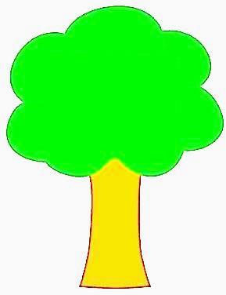

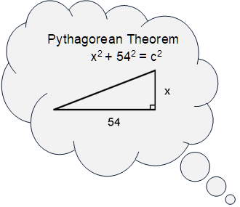


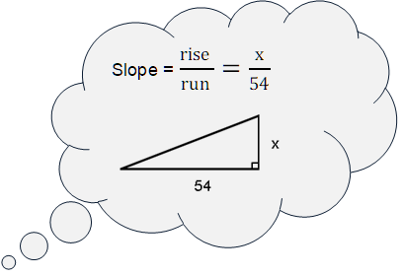

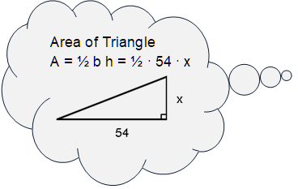
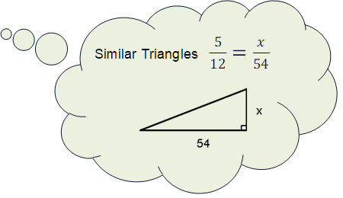
Inability to choose strategy often underlies poor math performance

Slide 28
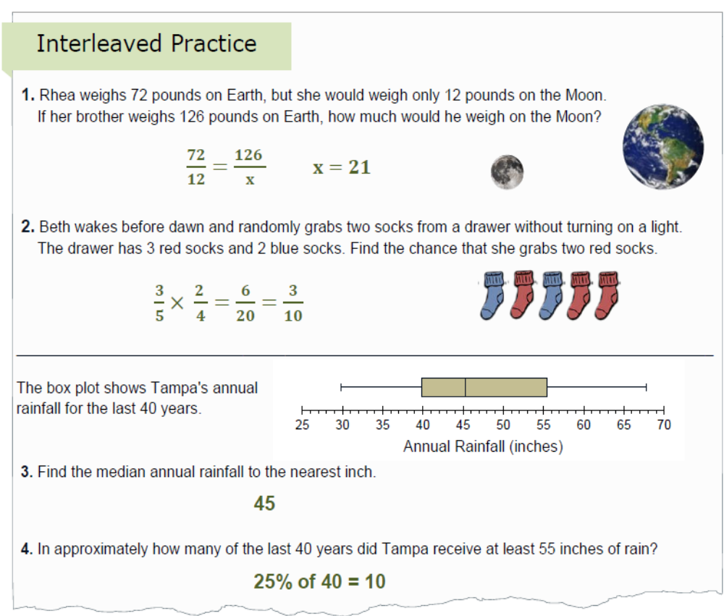
Obvious Remedy: Interleave problems (aka mixed review)

Slide 29
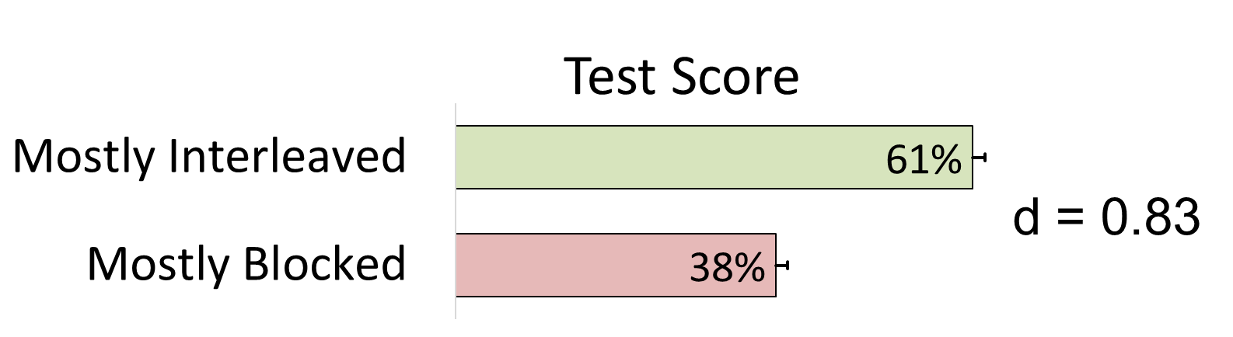
Math Interleaving Experiment
54 seventh-grade math classes in Hillsborough County
Each class randomly assigned to one of two conditions
Mostly Interleaved Practice | ⎯→ 10 Days |  | ⎯→ ⎯→ 33 days
 |  | Review Assignment |  | Unannounced Test
Mostly Blocked Practice
←⎯ 103 days ⎯→
Rohrer, Dedrick, Hartwig, and Cheung (2020). Journal of Educational Psychology

Slide 30
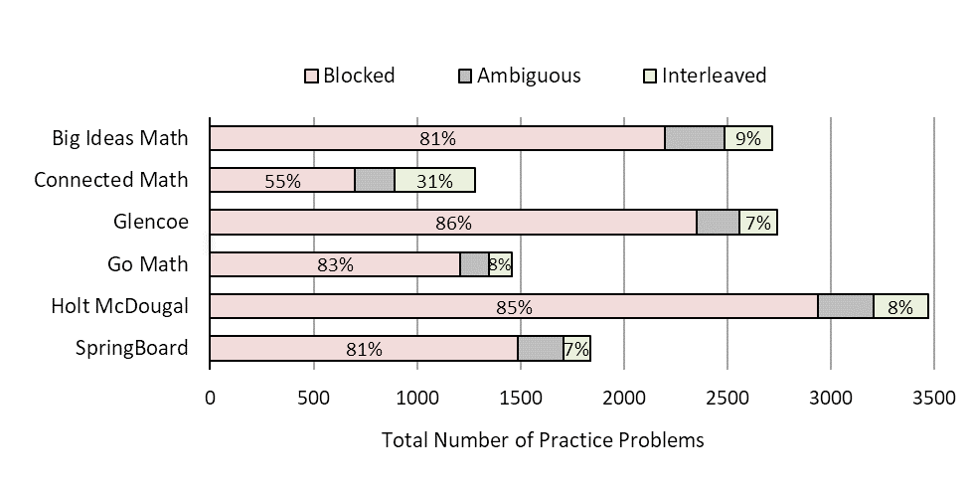
Yet blocked practice predominates most textbooks
Rohrer et al. (2020). Educational Psychology Review

Slide 31
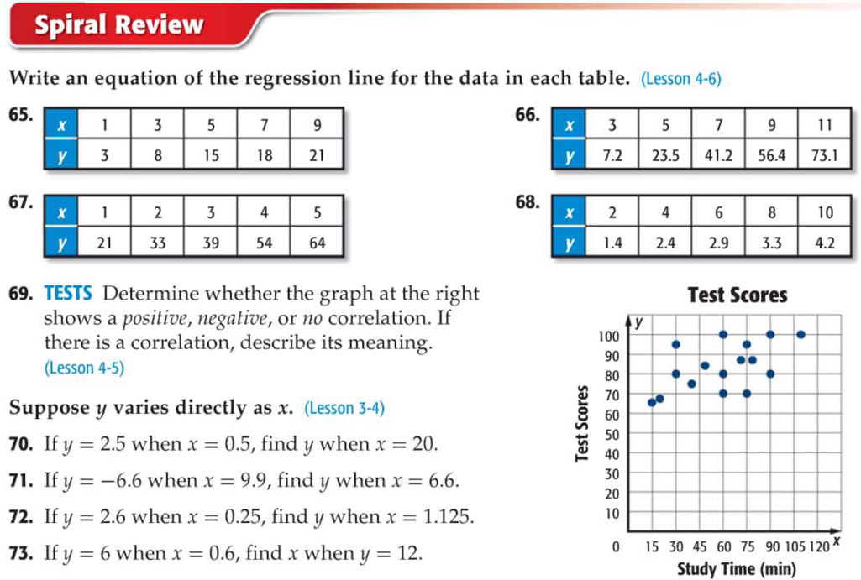
Even most review assignments include small blocks

Slide 32
Overview of Learning Strategies
Strategy Efficacy
repetition / rehearsing poor
highlighting/underlining poor
reading good if material is understood
answer feedback good
self-explanation good
retrieval practice good
spacing good
interleaving good for math and quantitative science
(For a review, see Dunlosky, Rawson, Marsh, Nathan, & Willingham, 2013)

Slide 33
In U.S., education methods are not evidence-based
Instead, most educational advice is based on…
armchair musings
theoretical blather
studies without final measure of learning
  (Though some ed school researchers advocate for empiricism over dogma.)

Slide 34
U.S. students perform poorly
Math Grade 8
TIMSS 2011
Notes:
Grade 8 TIMSS (2011)

Slide 35
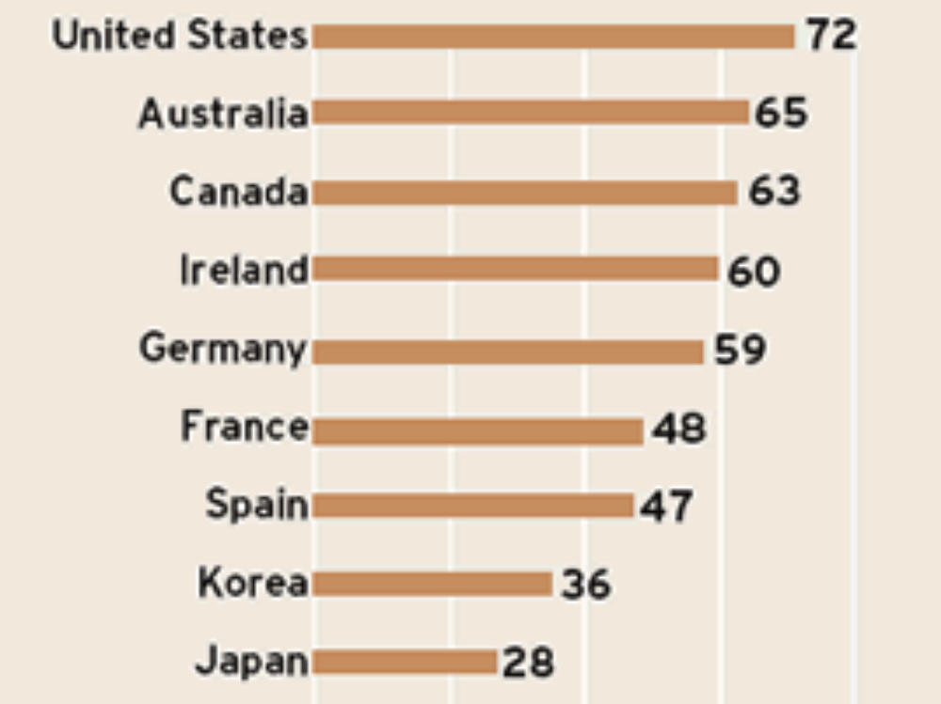
Survey Question: “I get good marks in mathematics.”
Percentage who Agreed or Strongly Agreed
Program for International Student Assessment (2003)

Slide 36
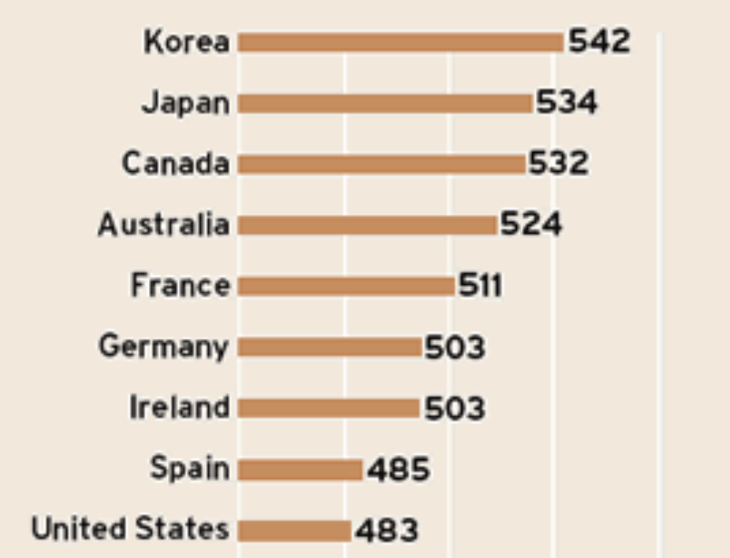
The same study measured performance ...

Slide 37
Educational approach has shifted in recent decades
Old Approach
We should help every child reach his or her potential.
Thus, our goal is to find better ways of learning.
New Approach
Every child has the same potential, so outcomes should be equal.
Thus, our goal is to explain away differences.
Many new ideas are not effective.
Growth Mindset
Learning Styles

Slide 38
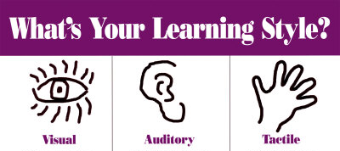
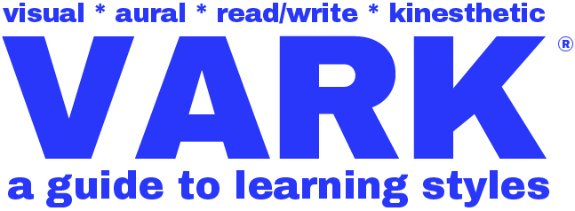
Learning Style Hypothesis (aka Meshing Hypothesis)
Student learns better if instructional method matches student’s learning style.
Procedure
Students are classified by style (e.g., visual vs. verbal)
Then students receive instruction tailored to their style.
This approach has been advocated by countless researchers and educators.
Assessments, customized instructions, teacher training cost many tax dollars.
But is there evidence?

Slide 39
The Learning Styles idea is intuitively appealing
The following statements are true.
Many students have a preferred learning style (visual, auditory, etc.).
Ms. A might excel on visual but not verbal tasks while Ms. B shows the reverse.
Sometimes students benefit from multiple styles (e.g., text and diagram).
But these facts provide no evidence for style-tailored instruction!

Slide 40
Data
APS convened panel of experts to examine data
Panel could not find good evidence.
“We conclude therefore, that at present, there is no adequate evidence base to justify incorporating learning styles assessments into general educational practice.”
(Pashler et al., 2009)
Since then, support for learning style interventions has fallen.

Slide 41
Conclusions about Learning Style
Combining multiple approaches can help.
Example
Text with diagram may be better than either alone.
Optimal approach varies by topic.
Examples
Geometry → visual instruction.
Literature → verbal instruction.
But there is no evidence for “customized instruction.”
(Coffield et al., 2004; Pashler et al., 2009)
Notes:
surgeon with spatial problem; lawyer with verbal problem?

Slide 42
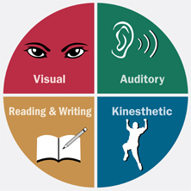
Defense of Learning Styles from VARK creator
The most damning criticism, about learning styles comes from researchers in the academic world. … It is usually stated in these terms; “There is no evidence that knowledge of one’s learning styles is a benefit to learning.”
…
There are many aspects of everyday life where there is a lack of evidence. There is not much evidence that the sun will rise tomorrow or that cellphones benefit communication or that there are parallel universes.
Fleming, N. (2012). The case against learning styles: “There is no evidence…”
http://vark-learn.com/wp-content/uploads/2014/08/The-Case-Against-Learning-Styles.pdf

Slide 43

Parents Of Nasal Learners Demand Odor-Based Curriculum
March 15, 2000 – The Onion
COLUMBUS, OH–Backed by olfactory-education experts, parents of nasal learners are demanding that U.S. public schools provide odor-based curricula for their academically struggling children.
A nasal learner struggles with an odorless textbook.

Slide 44

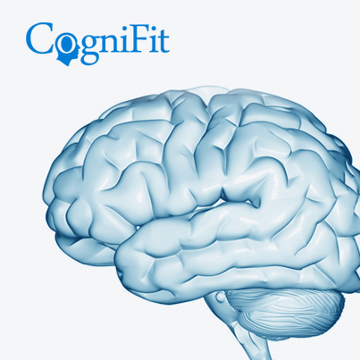
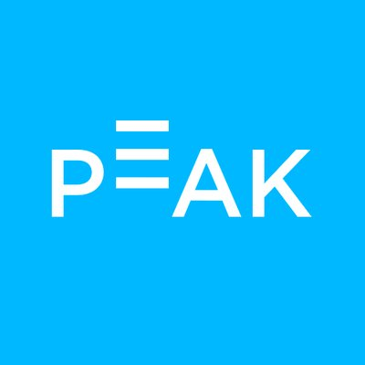
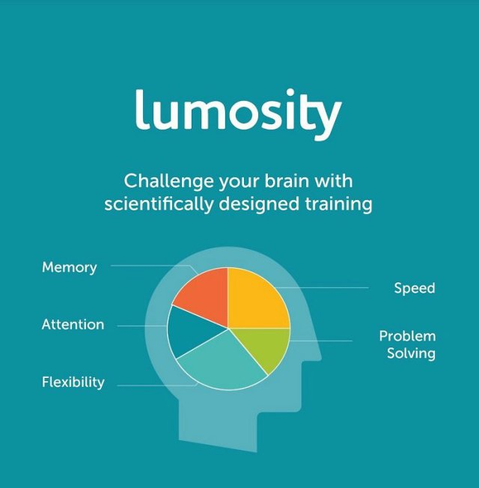
Brain Training Do brain training games work?
“Cogmed Working Memory Training is an evidence-based, computerized training program designed by leading neuroscientists to improve attention”
“CogniFit is …oriented to assess and improve cognitive health”

Slide 45
Brain training programs include a variety of cognitive tasks.
Most tasks involve working memory.
Example. N-back task
3-back task
R
No
No
No
No
Yes
No
Y
E
L
Y
P

Slide 46
Brain Training Experiment
52,617 adults registered for study, and 11,430 completed it.
Subjects randomly assigned to one of 3 kinds of training tasks
Group 1 Reasoning, planning, and problem-solving
Group 2 Short-term memory, attention, visuospatial skills, and math
(these tasks similar to those used by brain training products)
Controls General knowledge
Procedure
Pretest
6 weeks of training (subjects completed 24 training sessions, on average)
Posttest

Slide 47
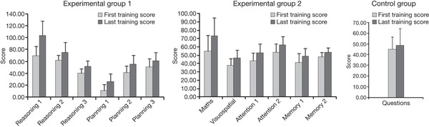
Results
All three groups improved on the tasks they practiced
Experimental Group 1 Experimental Group 2 Control
 First training score
 Last Training Score

Slide 48
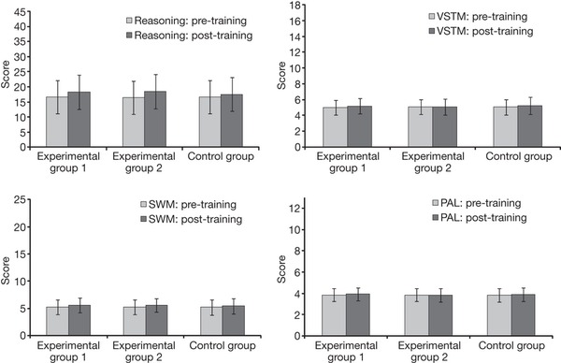
But neither group improved on tests of general ability.
Reasoning Verbal Short-Term Memory
Spatial Working Memory Paired-Associate Learning
Conclusion
“These results provide no evidence for any generalized improvements in cognitive function following brain training in a large sample of healthy adults.”
(Owen et al., 2010, Nature)
 Pretest
 Posttest

Slide 49

Expert panel examined brain training products
Main Findings
Products improve performance on trained tasks but not dissimilar tasks. In other words, there is no transfer.
Most of the studies have major design flaws, including
no control group, non-random assignment, small samples,
unplanned analyses, or no preregistration)
(Simons et al., 2016, PSPI)

Slide 50
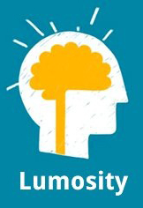
Maker of Lumosity received $2M fine for unfounded claims
January 5, 2016
Lumosity has been widely promoted though TV and radio advertisements… and used Google AdWords to drive traffic to their website, purchasing hundreds of keywords related to memory, cognition, dementia, and Alzheimer’s disease, according to the complaint.
The FTC alleges that the defendants claimed training with Lumosity would 1) improve performance on everyday tasks, in school, at work, and in athletics; 2) delay age-related cognitive decline and protect against mild cognitive impairment, dementia, and Alzheimer’s disease; and 3) reduce cognitive impairment associated with health conditions, including stroke, traumatic brain injury, PTSD, ADHD, the side effects of chemotherapy, and Turner syndrome, and that scientific studies proved these benefits.
https://www.ftc.gov/news-events/press-releases/2016/01/lumosity-pay-2-million-settle-ftc-deceptive-advertising-charges

Slide 51
The End

