Slide 1
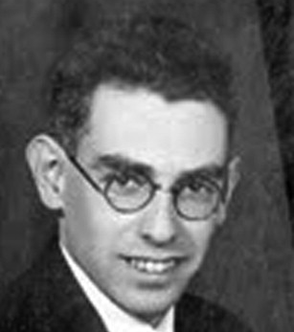
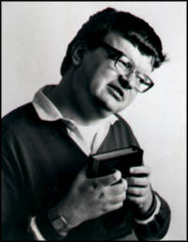

Memory Expertise
Some are born with a gift.
Some are not.
Solomon Shereshevsky
1886-1958
Daniel Tammet
1979-
Kim Peek
1951-2009

Slide 2
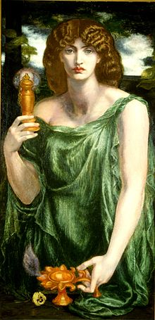
mnemonic a learning strategy for a specific kind of material
ROY G. BIV
Stalactites on the ceiling, stalagmites on the ground
King Phillip Came Over For Great Spaghetti
Please Excuse My Dear Aunt Sally
SOH - CAH - TOA
Mnemosyne
Greek goddess
of memory

Slide 3
peg-word mnemonic
Used to learn a list of 10 or fewer items in a particular order
(e.g., first 10 amendments)
Step 1. Learn peg-words. 1-bun 6-sticks
2-shoe 7-heaven
3-tree 8-gate
4-door 9-vine
5-hive 10-hen
Step 2. Form bizarre image of peg-word & study item

Slide 4
Demo
Close your eyes and listen to words.
For each word, form interactive image between word and peg word.
1. bun elephant
2. shoe sailboat
3. tree clock
4. door foot
5. hive rainbow
6. sticks telephone
7. heaven radio
8. gate corn
9. vine brain
10. hen bottle

Slide 5
Now try to recall words in order
1. bun elephant
2. shoe sailboat
3. tree clock
4. door foot
5. hive rainbow
6. sticks telephone
7. heaven radio
8. gate corn
9. vine brain
10. hen bottle

Slide 6
Bill of Rights (First 10 Amendments to the Constitution)
1. freedom of speech, press, religion, assembly
2. bear arms
3. no soldier may stay in house without owner’s consent
4. reasonable search and seizure
5. grand jury; no self-incrimination; no double jeopardy
6. speedy public trial, may confront witness
7. trial by jury
8. no cruel or unusual punishment (or excessive bail)
9. there are other rights besides those listed here
10. states have powers not delegated or prohibited by constitution

Slide 7
Cranial Nerves
1 olfactory
2 optic
3 oculomotor
4 trochlear
5 trigeminal
6 abducens
7 facial
8 vestibulo/cochlear
9 glossopharyngeal
10 vagus
11 spinal accessory
12 hypoglossal

Slide 8
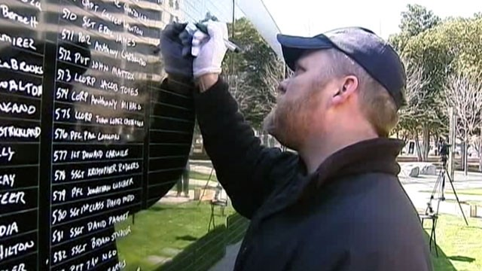
March 3, 2013 – ABC News
It was a solemn scene Thursday as U.S. Navy veteran Ron White stood at a black wall in downtown Fort Worth and wrote in white the full name and rank of each of the 2,200 military members who had died in Afghanistan. White had no list. He had memorized the 2,200 names and ranks, more than 7,000 words.
White is a two-time USA Memory Champion who has made memorization his business over the past 22 years. He began working on memorizing the 2,200 names in May 2012, using the loci method.
"Essentially, what you do is you memorize a map of your city, your town where you live," White said. "So, there's 2,200 service members who paid the ultimate sacrifice. So that means I memorized 2,200 locations in my hometown of Forth Worth, Texas.” The locations included places and signposts like stop signs, trees, walls, pictures, restaurant booths and restaurant cash registers. He then took each name and turned it into a picture that reminded him of that person, and he visualized a name at each location.
"When I was at the wall, I simply stood at the wall and took an 11-hour mental walk around downtown Fort Worth and wrote out the names," White said.

Slide 9
method of loci
Similar to peg-word method, but cues are pre-learned locations along a path
loci = locations, locus = location
Example
My bed elephant
My dresser sailboat
My closet clock
My sofa foot
My TV rainbow
My fridge telephone
My stove radio
My oven corn
My sink brain
My garage bottle
⋮ ⋮ ⋮

Slide 10
Method of Loci attributed to the following legend
The Greek poet Simonides was at a banquet. He stepped outside to talk to messengers, and, while he was outside, the roof of the banquet hall collapsed, killing everybody inside. The mangled corpses could not be identified, but Simonides was able to identify every victim by visualizing where everyone had been sitting.
-- Cicero

Slide 11
Mnemonists
  Some people have astonishing memory.
  These memory savants are born – not made.

Slide 12
HSAM
60 minutes (13:38) https://www.youtube.com/watch?v=2zTkBgHNsWM
OR https://www.youtube.com/watch?v=oHeEQ85m79I

Slide 13
(Highly) Superior Autobiographical Memory (HSAM or SAM)
People with SAM remember virtually every day since their early teenage years.
After 60 Minutes report aired, more than 100 people contacted lab.
When tested, about 30 qualified as an “HSAM individual.”
Sample Test item
Subject given randomly-chosen date since their 15th birthday
More than 90% correctly provided day of the week
But their memory expertise was limited to events (see next slide).
LePort et al. (2012)

Slide 14
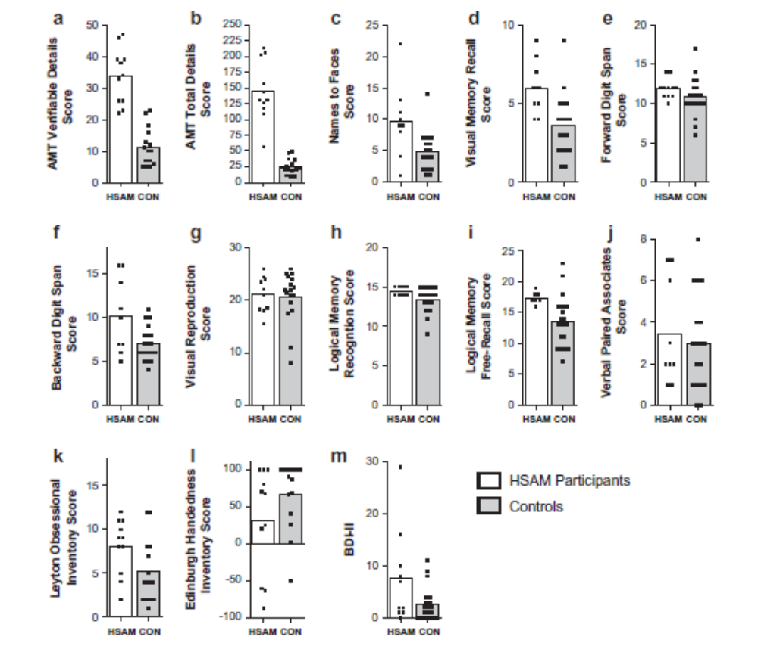
HSAM’s expertise limited to Autobiographical Memory Tests (panels a and b)
LePort et al. (2012)

Slide 15
SS
Once repeated 70-digit sequence after 15-year delay.
“Yes, yes. This was a series you gave me when we were in your apartment You were sitting at the table and I in the rocking chair. You were wearing a gray suit and you looked at me like this. Now, then, I can see you saying ...”
Luria, A. (1987). The mind of a mnemonist.
Relied heavily on vivid imagery, even for digits
“Take the number 1. This is a proud, well-built man; 2 is a high-spirited woman; 3 is a gloomy person (why, I don’t know); 6 is a man with swollen feet; 7 a man with a mustache; 8 a very stout woman.”
Solomon Shereshevsky
1886-1958
Notes:
Solomon Veniaminovich Shereshevsky (1886–1958)

Slide 16
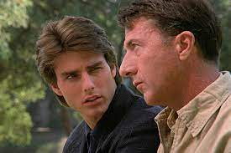
Kim Peek
“He has memorized more than 7,600 books. He can recite the highways that go to each American city, town or county, along with the area and zip codes, television stations and telephone networks that serve them. If you tell him your date of birth, he can tell you what day of the week it fell on… He is also developmentally disabled and depends on his father for many of his basic daily needs. His abilities provided the inspiration for the character Raymond Babbitt, whom Dustin Hoffman played in the 1988 movie Rain Man.”
-- Treffert and Wallace (2004)
Peek was born
without a
corpus callosum
Kim Peek
1951-2009
Notes:
Kim Peek was born without a corpus callosum

Slide 17
Daniel Tammet: Memory/Calculator/Calendar Savant
Has Asperger’s but no cognitive impairments
Wrote multiple books
Recited 22,514 digits of π
Speaks at least 11 languages.
Learned Icelandic in one week
Has trouble recognizing faces
60 minutes (13:10) https://www.youtube.com/watch?v=zjNvUIoqc80
Daniel Tammet
1979-

Slide 18
What have we learned from memory savants?
Their heavy use of imagery suggests that imagery is a powerful mnemonic.
Darold Treffert
2010 Islands of Genius: The Bountiful Mind of the Autistic, Acquired, and Sudden Savant
2020 Extraordinary People: Understanding Savant Syndrome

Slide 19
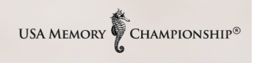
https://www.usamemorychampionship.com/
https://www.youtube.com/watch?v=p0zmLo_edeo (6:01)
2000 competition: Scientific American Frontiers Segment 2 (about 15 min)
http://www.chedd-angier.com/frontiers/season11.html
Episode 2: Segment begins at 13:52

Slide 20
Poem for U.S. 2006 Championships
When I am old and gray, and life has run her course through my veins, I shall stand before a beveled glass of reckoning ~ and I shall weep. Like rain to a parched and arid soul, my tears shall fall into the ravine of my heart ~ and then shall I survey the serpentine’d path of my soul’s Sadhana. I shall bow my head beneath the weighted glory of mem’ry, and pray to know that all I have done, I have done well.
I shall reach, with hands withered and veined, for the finer silk of love’s gentle thread, which interwove itself through the fabric of who I was and who I became ~ in those yesterdays, which are now my todays. As striated lights against the lens of my perception, the colors of my being shall explode across my vision ~ rendering me speechless with wonder at vast potential explored; destiny pondered and embraced.
When I am old and gray, the awe in which I have lived my life shall wear as a mantle, woven upon legacy’s loom: stretched taut across the framework of purpose, and driven hard by courage, and tenacity, and the indefatigable determination to draw all mediocrity out of the thread on which I toiled, and over which I prayed.
And you shall be there, weaver’s teacher: strong and steady stream of light which guided the spindles, threaded the bobbin ~ and somehow kept tapestry’s perfection in mind; forever blueprinting the pattern into my heart.
But let me not wait for tomorrow, to touch the fabric of this life; to hold close the breathing aliveness of a storm’s invisible power to electrify, and to set my spirit ablaze. Let me not wait another moment to peer through the beveled glass, and find perfection’s refraction, reflected.
Let me enjoy, today, the magic of the journey ~ Sadhana’s tapestry rich of texture and vibrant of color! Let me breathe in the aromatherapeutic essence of choice, and a destiny fulfilled, with every step I take upon a journey into the heart of me!
Let me find the Holy Grail today ~ while youth still dances in my spirit, and grace aligns my feet to a path firm and true ~ and set before me as surely as a dance hall ticket, already purchased.
Let my tears be of joy, which dry upon the loom ~ bleeding their way into every careful stitch and turn. And when I am done, and the tapestry is complete ~ I shall know only peace, at having been blessed to sit beside you, all these years, to share the soul and heart which have bonded us together since the beginning.

Slide 21
World Memory Championships
Includes dozens of events
Event World Record (as of Oct 2025)
5 min to learn list of random digits 630 Andrea Muzii, Italy
15 min to learn list of random words 318 Katie Kermode, England
https://iam-stats.org/records.php

Slide 22
To attain rank of grand master, you must
1) memorize 1,400 randomly-ordered digits in an hour
2) memorize the order of 14 shuffled decks of cards in an hour
3) memorize the order of one shuffled deck of cards in under 40 seconds.
As of 2016, there were 154 grand masters in the world.
https://en.wikipedia.org/wiki/Grand_Master_of_Memory

Slide 23
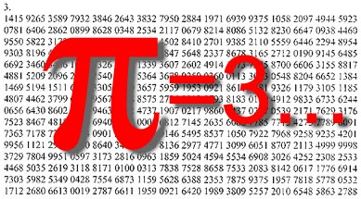
memorizing digits of pi

Slide 24
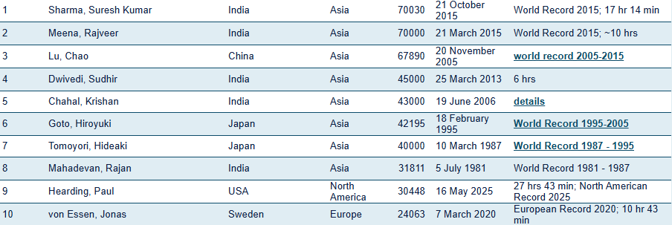
Top 10 performances π = 3.14159… (as of October 2025)
http://www.pi-world-ranking-list.com/index.php?page=lists&category=pi
Notes:
Martin Conway and Susan Gathercole (married) - “They take long, romantic walks during which he recites a few places of π, then she says a few, then he says a few.” (Kalat, 2002)

Slide 25
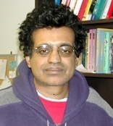
Pi Guy
Rajan Mahadevan
Recited 31,811 digits of π 5 July 1981
“After a hard day, I like to go home and
memorize a few more digits of pi.”
Biderman et al. (1992). Unexceptional spatial memory in an exceptional memorist.
Journal of Experimental Psychology: Learning, Memory, and Cognition.
Rajan Mahadevan
1957-
BA Psychology
MA Clinical Psychology
Notes:
“After a hard day, I like to go home and memorize a few more digits of pi.” - Rajan Mahadevan

Slide 26
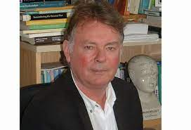

Pi Lovers
“They take long, romantic walks during which he recites a few places of π, then she says a few, then he says a few.”
(Kalat, 2002)
Martin Conway
1952-2022
Susan Gathercole
1958-

Slide 27
The End

Slide 28
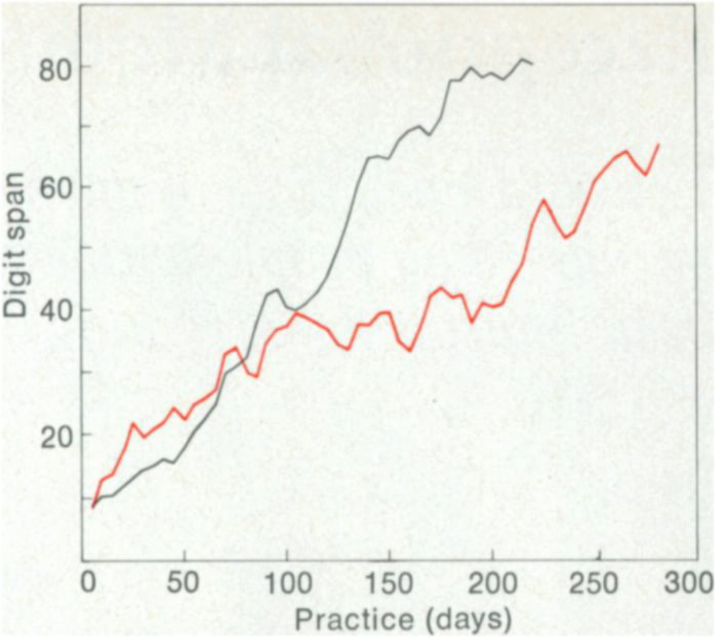
Another Caveat: Measures of span disallow Ss who use long-term memory.
Digit Span Study
Two Ss practiced digit span during 220+ sessions over 20 months.
Both Ss used strategies.
“[SF] remembered 3492 as
3 minutes and 49.2 seconds, near
world-record time for running a mile.”
(Ericsson & Chase, 1982, p. 609)
SF
BB

