Slide 1
Lecture 0
Course Overview

Slide 2
Methods Review
Limited to methods used in basic experimental psychology
Experiment vs. correlation
IV, DV, factorial design, two-way interactions
None of the following:
significance tests (e.g., t-test, ANOVA)
regression
modeling

Slide 3
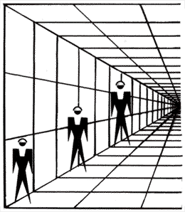
Visual Perception

Slide 4
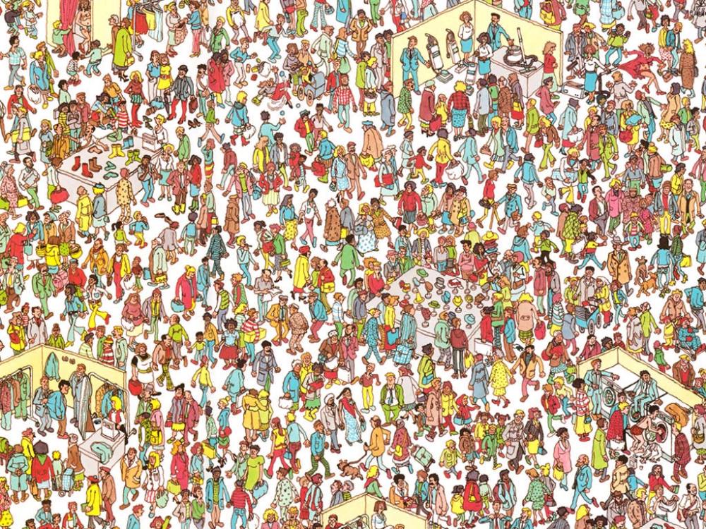
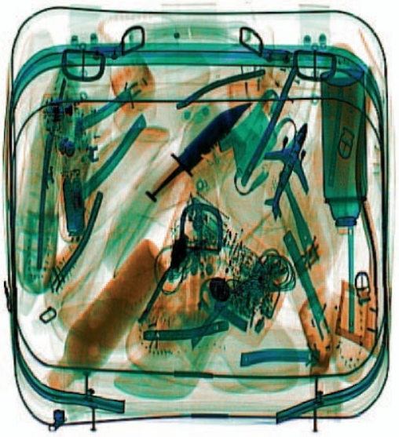

Visual Search

Slide 5
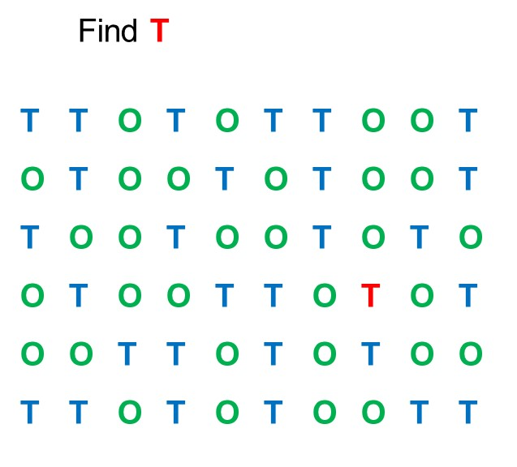
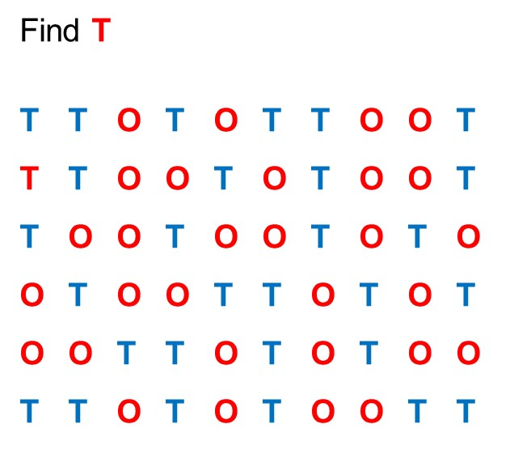
Selective Attention

Slide 6
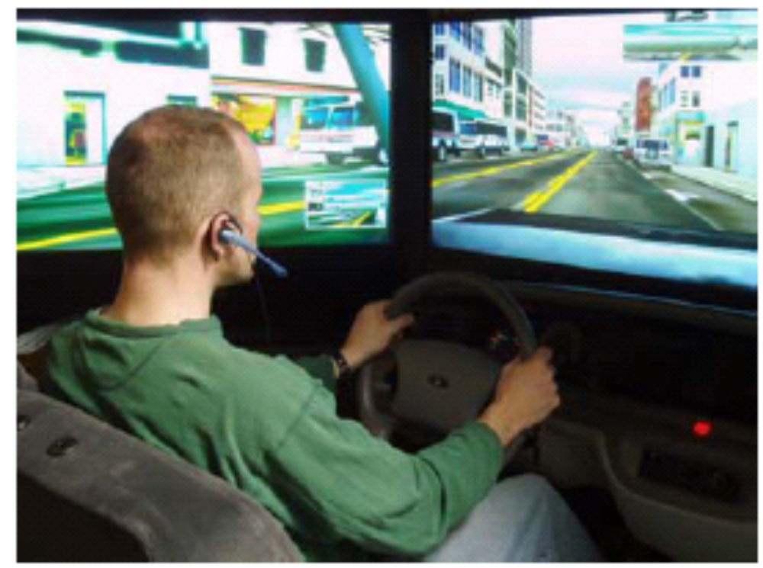
Divided Attention

Slide 7
Recall
Is it true that we never forget a flashbulb memory?
Are Tip-of-the-Tongue feelings real?

Slide 8

Face Recognition
When is eyewitness memory reliable, if ever?

Slide 9
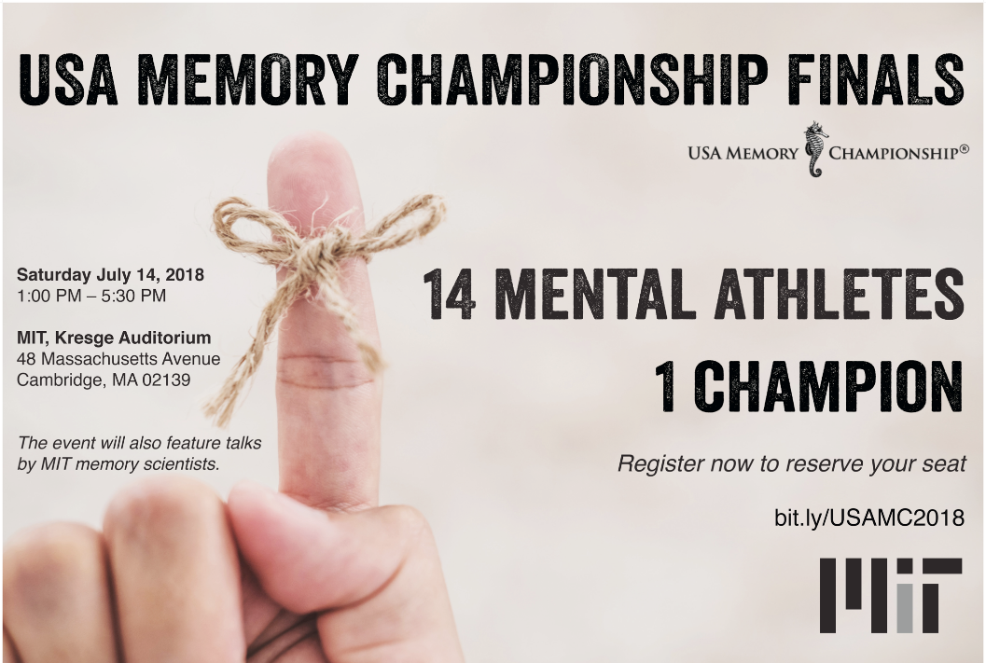
Memory Expertise

Slide 10
Learning
Which learning strategies are best? Which should be avoided?
When should you wait until the last night to study for a test?
Do students have different “learning styles?”
If so, does it help if instruction is tailored to your style?

Slide 11
False Memory
Can memories be repressed and then recovered?
Are flashbulb memories immune to forgetting?

Slide 12
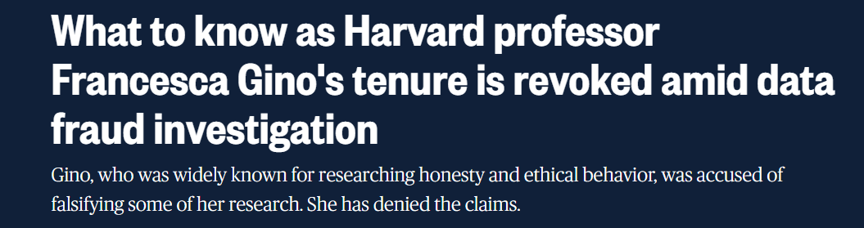
Priming
The replicability crisis…
https://www.nbcnews.com/news/us-news/know-harvard-professor-francesca-gino-tenure-revoked-data-fraud-invest-rcna209219

Slide 13
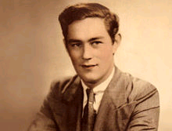
Amnesia
“Right now, I’m wondering, have I done or said anything amiss? You see, at this moment everything looks clear to me, but what happened just before? That’s what worries me. It’s like waking from a dream; I just don’t remember.”
(Milner, 1970)
Henry Gustav Molaison (1926-2008)

Slide 14
Judgment
Why do people buy lottery tickets, even if they know that they will likely lose money in the long run (unlike the stock market)?

Slide 15
The End

